Slide 1





Enabling Virtual Priority in Data Center Congestion Control
Zhaochen Zhang, Feiyang Xue, Keqiang He, Zhimeng Yin, Gianni Antichi,
Jiaqi Gao, Yizhi Wang, Rui Ning, Haixin Nan, Xu Zhang, Peirui Cao,
Xiaoliang Wang, Wanchun Dou, Guihai Chen, Chen Tian

Slide 2

The Need for a Large Number of Priority Queues
In general, priority queues serve two primary purposes:
1
2
Providing traffic isolation for different traffic classes
Performing traffic scheduling in the same traffic class
Real-time services
Distributed computing jobs
Traffic
scheduling algorithm
Background
tasks
Priority queues weighted share the bandwidth
The higher priority queue is strictly prioritized

Slide 3
The Need for a Large Number of Priority Queues
To meet both purposes, a large number of queues are required:
1
2
Providing traffic isolation for different traffic classes
Performing traffic scheduling in the same traffic class
Real-time services
Queue requirement:
Number of traffic classes
Queue requirement:
Typically 8, more is better*
Distributed computing jobs
Traffic
scheduling algorithm
Background
tasks
*PIAS@NSDI’15, QCLIMB@NSDI’24
Total queue demand is the product of # traffic classes and # scheduling priorities

Slide 4
Only a Few Priority Queues Are Offered
Direct reason: Priority-related protocols limit the number of priority queues.
1
2
PFC only supports 8 priorities
in its header format
DSCP only supports 12 priority mapping as per the standard
PFC enable vector
DSCP 001010
Cisco switch
0
1
0
0
1
0
0
0
DSCP 001100
8
HP switch
PFC frames utilize an 8-bit bitmap to
denote the paused or resumed priorities.
Non-standard DSCP map to different queues across different manufacturers' switches.
Current commercial switches typically support only 8 or 12 priority queues.

Slide 5
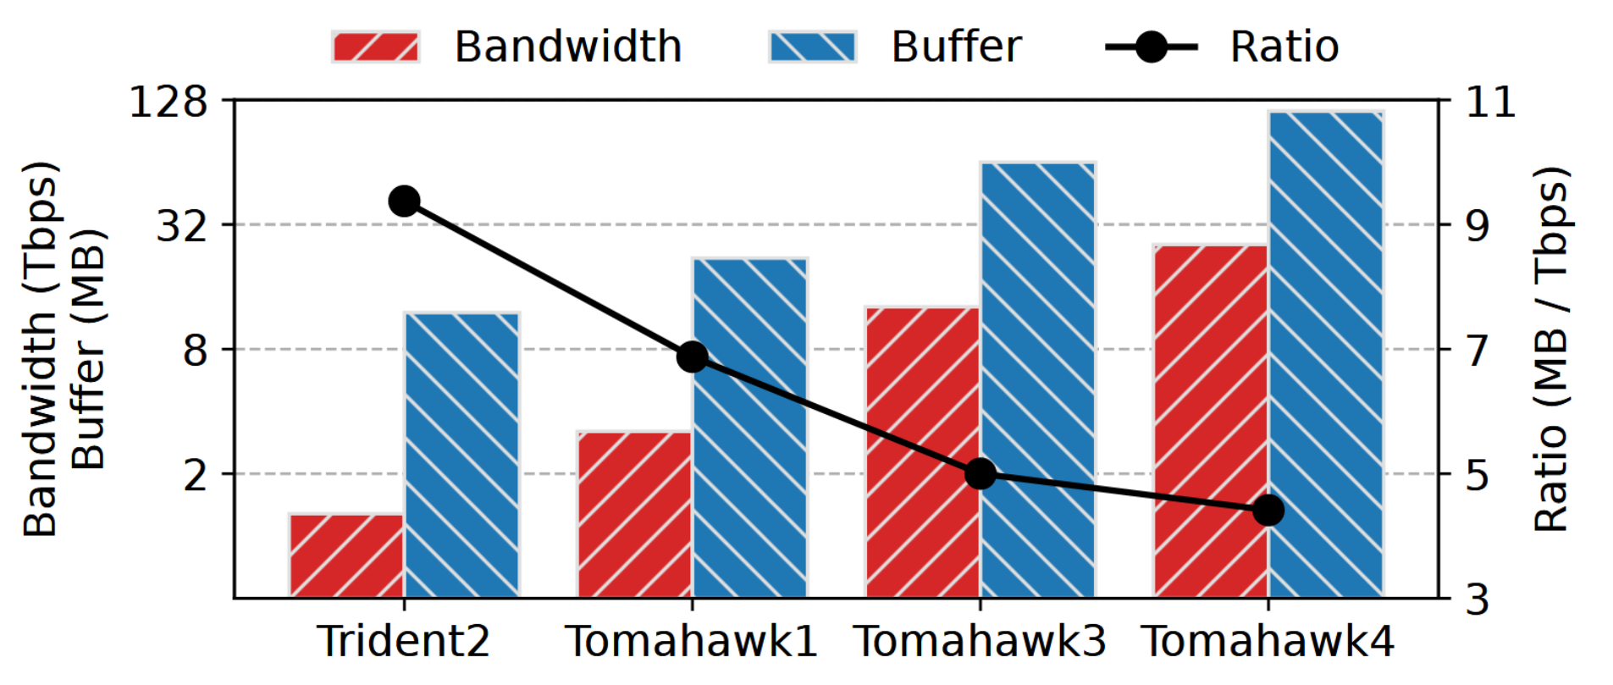
Only a Few Priority Queues Are Offered
Trend: The decreasing buffer-to-bandwidth ratio in switches limits the number of priority queues.
Microsoft@Sigcomm’16: only accommodate two lossless priorities on Trident2 to conserve buffer space.

Slide 6
Virtual Priority is an Attractive Solution to the Shortage
Virtual priority: the capability of supporting multiple strict priorities within a single physical priority queue.
Virtual priority must achieve the following objectives:
O1: Multi-priority assurance.
O2: Work conservation.
The virtual priority mechanism must ensure strict prioritization of higher-priority traffic.
The virtual priority mechanism should aim to fully utilize bandwidth without any waste.

Slide 7
Virtual Priority is an Attractive Solution to the Shortage
With virtual priority, the limited physical priority queues could be reserved for isolation across different traffic classes.
Physical priority
9 priority queues for 3 traffic classes isolation and 3 scheduling priorities
Virtual priority
3 priority queues for traffic isolation, no queues need for scheduling
Real-time services
Real-time services
Distributed computing jobs
Distributed computing jobs
Background
tasks
Background
tasks

Slide 8
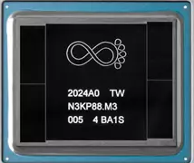
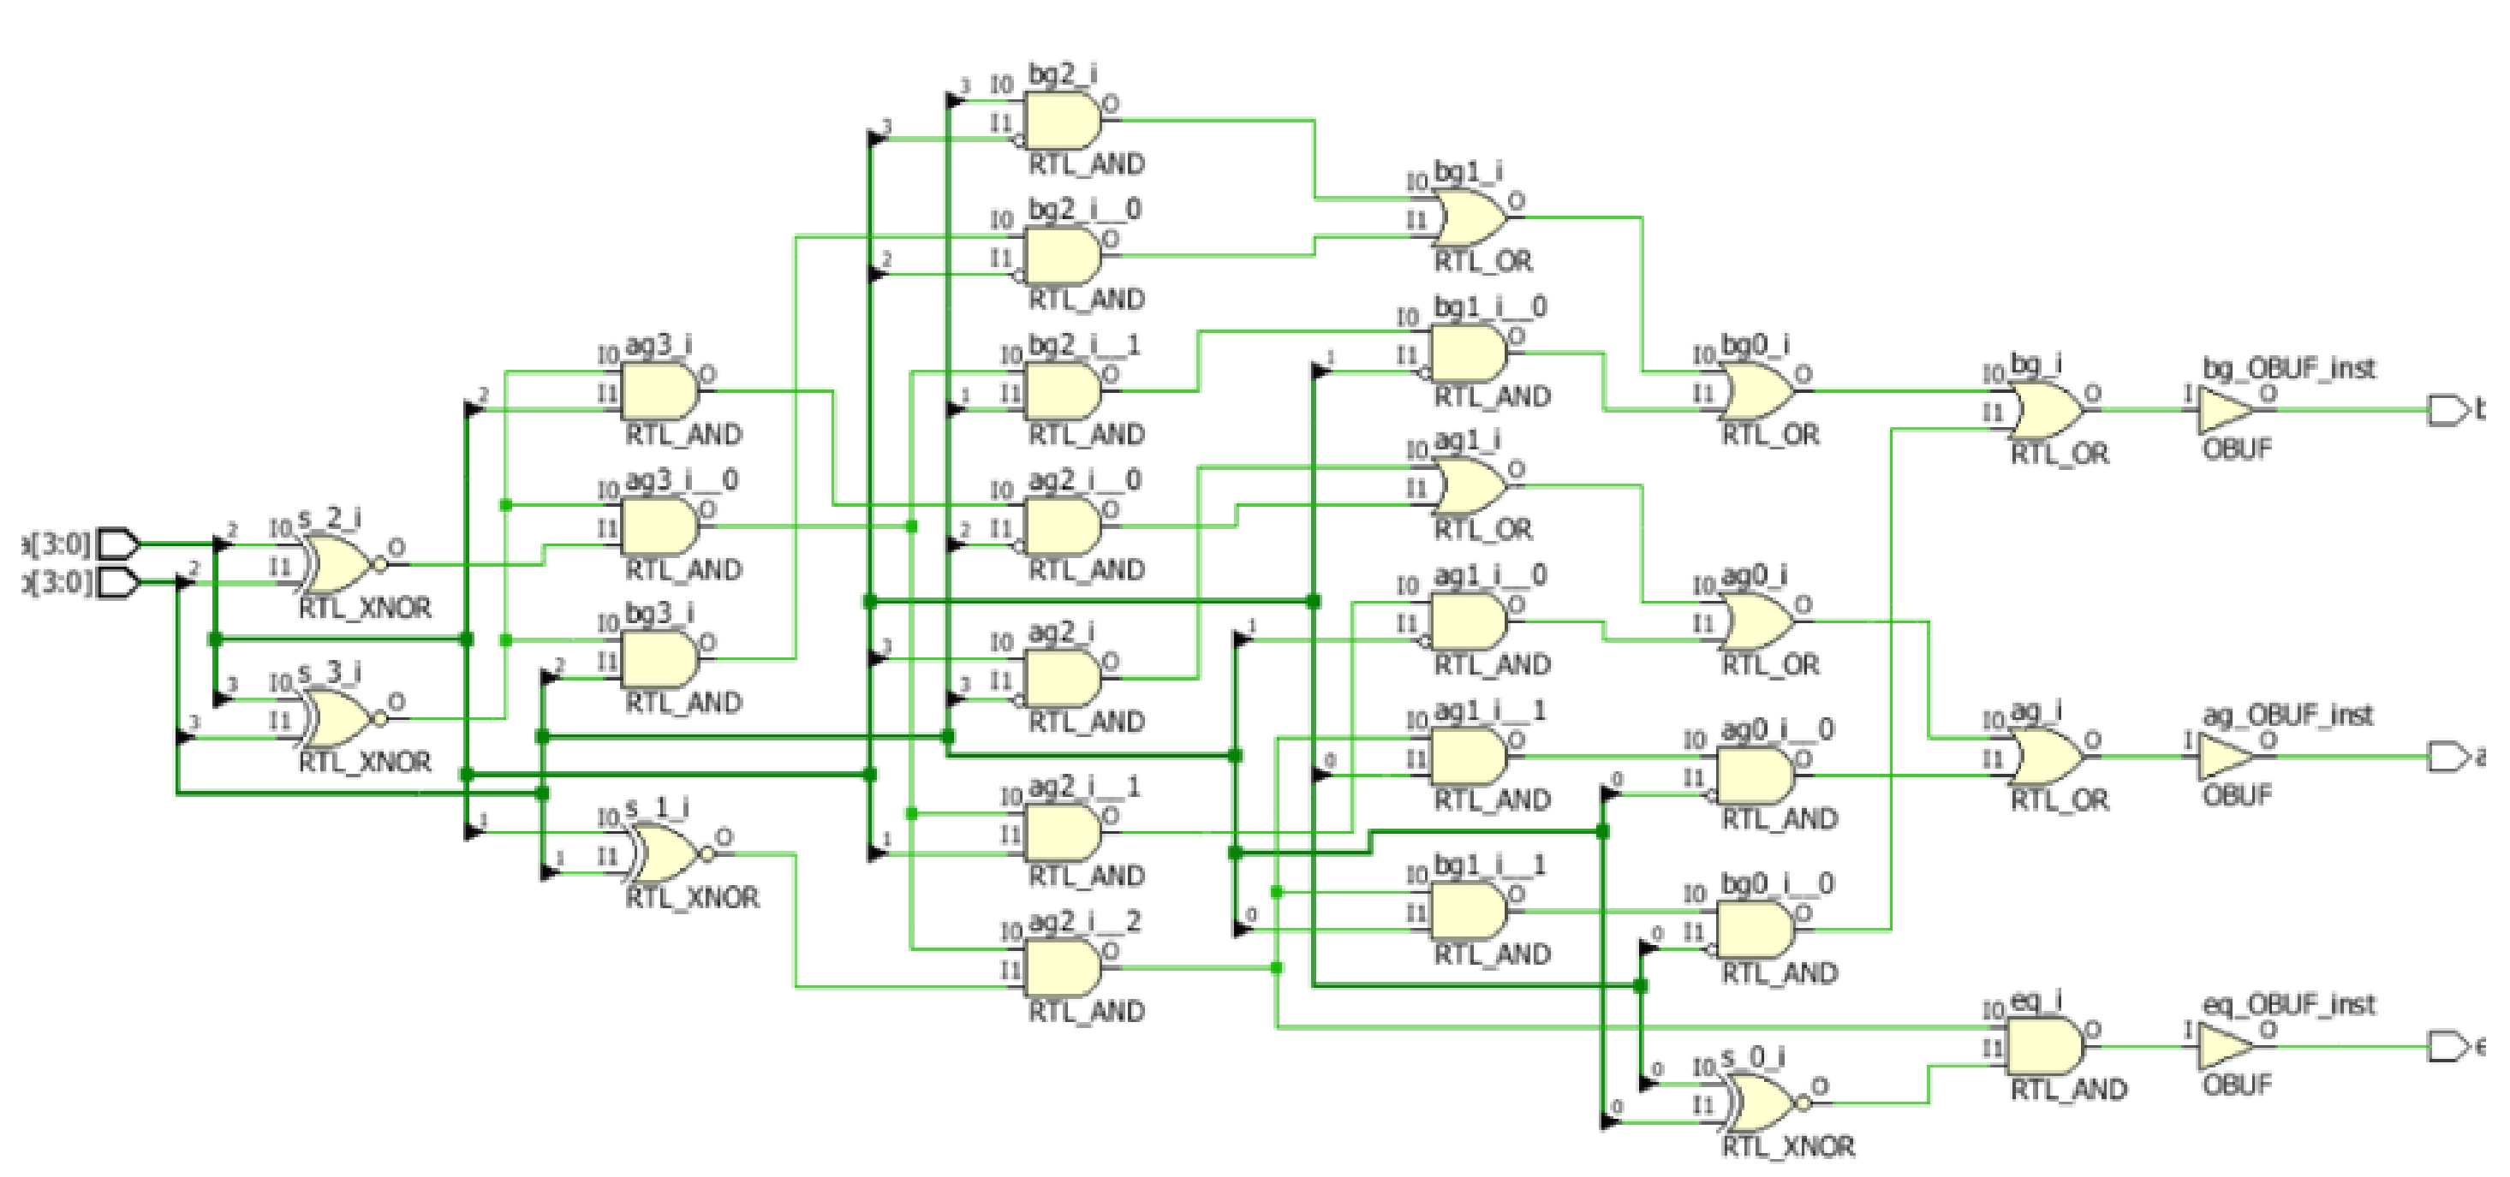
Existing Virtual Priority Solutions are not Readily Deployable
Existing virtual priority technologies primarily involve packet scheduling algorithms that operate on switches. They necessitate:
Programmable switches
N. K. Sharma et al. @NSDI20
AIFO@Sigcomm21, HCSFQ@NSDI21, ……
Additional specialized hardware
pFabric@Sigcomm13, PIFO@Sigcomm16, BBQ@NSDI24, vPIFO@Sigcomm24, ……
or
Figure source: Intel Tofino2
Figure source: BBQ@NSDI24

Slide 9

Existing Virtual Priority Solutions are not Readily Deployable
Existing virtual priority technologies primarily involve packet scheduling algorithms that operate on switches. However, they necessitate:
Can we achieve virtual priority
without switch replacement/upgrades?
Programmable switches
N. K. Sharma et al. @NSDI20
AIFO@Sigcomm21, HCSFQ@NSDI21, ……
Additional specialized hardware
pFabric@Sigcomm13, PIFO@Sigcomm16, BBQ@NSDI24, vPIFO@Sigcomm24, ……
Figure source: Intel Tofino2
Figure source: BBQ@NSDI24

Slide 10
Our Insight
Virtual priority can be achieved by carefully managing bandwidth contention among flows within a physical priority queue, a task traditionally handled by the Congestion Control (CC) at the host.

Slide 11
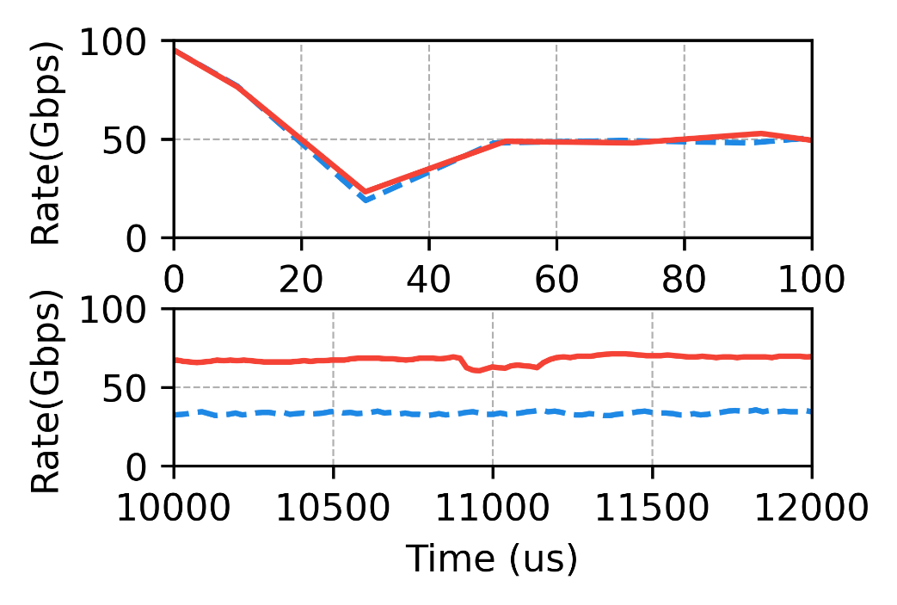
Existing CC can not Achieve Virtual Priority
D2TCP, the state-of-the-art data center CC that can prioritize a proportion of traffic.
High-priority flow
Low-priority flow
Queue Length
Kmin
Time
Rate
Time
2 D2TCP flows in the simulation
Analysis of D2TCP’s behavior

Slide 12
Existing CC can not Achieve Virtual Priority
D2TCP, the state-of-the-art data center CC that can prioritize a proportion of traffic.
High-priority flow
Low-priority flow
Queue Length
Kmin
Time
Rate
Violate O1：
Multi-priority
assurance
Time
2 D2TCP flows in the simulation
Analysis of D2TCP’s behavior

Slide 13
Existing CC can not Achieve Virtual Priority
CC based on the single-bit congestion signal can not achieve virtual priority.
High-priority flow
Low-priority flow
Queue Length
Kmin
Time
Rate
Violate O1：
Multi-priority
assurance
Time
2 D2TCP flows in the simulation
Analysis of D2TCP’s behavior

Slide 14
Virtual Priority CC Needs Multi-bit Congestion Signal
Ideally, setting higher congestion thresholds for higher priorities can achieve virtual priority.
High-priority flow
Low-priority flow
Queue Length
Delay
High
Kmin
target
Low
Time
target
Time
Rate
Rate
Time
Time
Analysis of D2TCP’s behavior
Ideal virtual priority CC behavior

Slide 15
Our Insight
Virtual priority can be achieved by carefully managing bandwidth contention among flows within a physical priority queue, a task traditionally handled by the Congestion Control (CC) at the host.
CC that supports virtual priority requires a multi-bit congestion signal and setting distinct congestion thresholds for flows with different priorities.

Slide 16
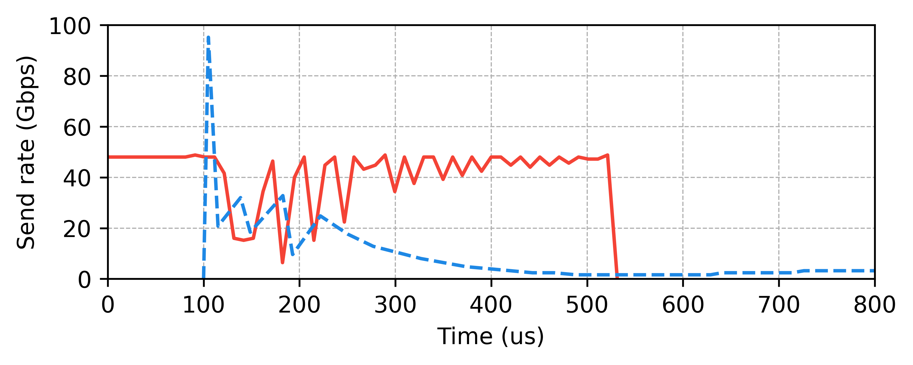
Observation: need careful balance between O1 and O2
Violate O1：
Multi-priority
assurance
Violate O2：
Work conservation
2 High-priority Swift flows and 2 Low-priority Swift flows in the simulation

Slide 17
Observation: need careful balance between O1 and O2
Many existing CC designs are not suitable for virtual priority CC, which fail to balance multi-priority assurance (O1) with work conservation (O2).
Violate O1：
Multi-priority
assurance
Violate O2：
Work conservation
2 High-priority Swift flows and 2 Low-priority Swift flows in the simulation

Slide 18
Observation: need careful balance between O1 and O2
Many existing CC designs are not suitable for virtual priority CC, which fail to balance multi-priority assurance (O1) with work conservation (O2).
PrioPlus
a congestion control enhancement algorithm that can be integrated into existing delay-based CCs to enable virtual priority.
Violate O1：
Multi-priority
assurance
Violate O2：
Work conservation
2 High-priority Swift flows and 2 Low-priority Swift flows in the simulation

Slide 19
PrioPlus’s Key Concept: Delay Channel
PrioPlus assigns specific delay ranges, termed as channels, to each priority.
Delay
Delay channel of the higher priority
Delay channel of this priority
Delay channel of the lower priority

Slide 20

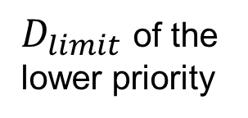

PrioPlus’s Key Concept : Delay Channel
PrioPlus assigns specific delay ranges, termed as channels, to each priority.
Delay
Delay channel of the higher priority
$$D_{limit}$$
Delay channel of this priority
$$D_{target}$$
$D_{limit}$ of the
lower priority
Delay channel of the lower priority

Slide 21


PrioPlus’s Workflow
High-priority flow
Low-priority flow
Delay
$D_{target}$ of
high priority
$D_{target}$ of
low priority
Linear start
Time
Rate
Finish
Dual-RTT adaptive increase
Probe
Start
Time

Slide 22
PrioPlus’s Workflow
High-priority flow
Low-priority flow
Delay
$D_{target}$ of
high priority
$D_{target}$ of
low priority
Linear start
Time
Rate
Finish
Dual-RTT adaptive increase
Probe
Start
Time

Slide 23


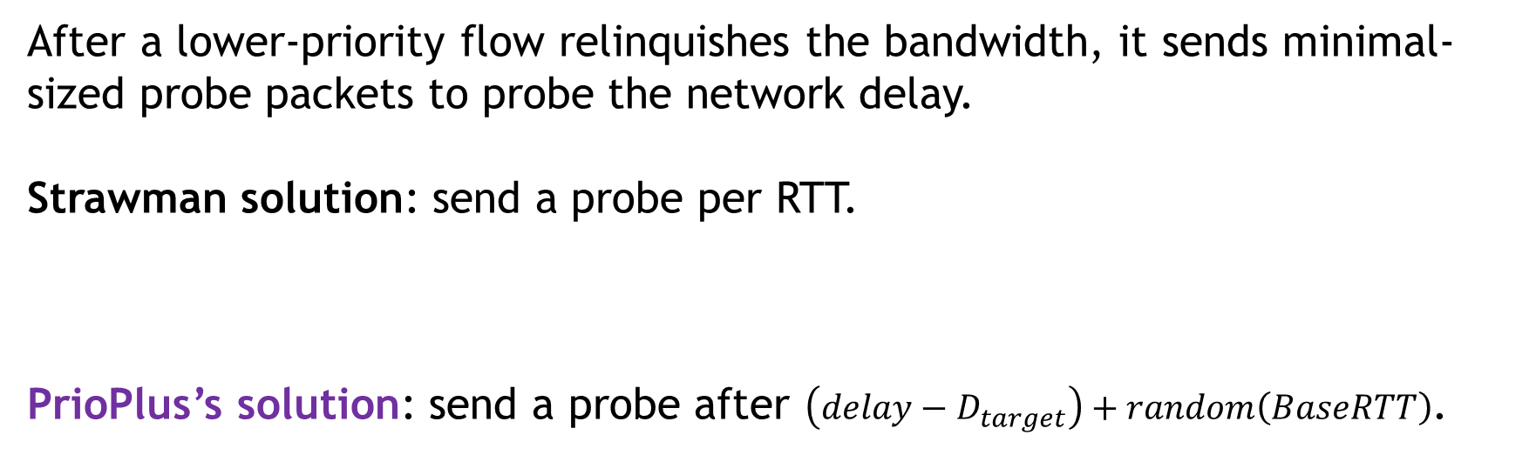
PrioPlus Design: Probe with Collision Avoidance
After a lower-priority flow relinquishes the bandwidth, it sends minimal-sized probe packets to probe the network delay.
Strawman solution: send a probe per RTT.
PrioPlus’s solution: send a probe after $\left(delay−D_{target}\right)+random\left(BaseRTT\right)$.
Collisions: flow restart transmission synchronously.
Bandwidth occupancy: typically 42 Mbps per flow.
Lower bandwidth occupancy while higher priority has higher probe frequency.
Fewer collisions.
See our paper for PrioPlus’s solution on probe loss.

Slide 24
PrioPlus’s Workflow
High-priority flow
Low-priority flow
Delay
$D_{target}$ of
high priority
$D_{target}$ of
low priority
Linear start
Time
Rate
Finish
Dual-RTT adaptive increase
Probe
Start
Time

Slide 25
PrioPlus Design: Linear Start
When facing an uncertain environment, a flow should start bold yet meticulous.
Starting too slow will lead to delayed data transmission.
Starting too fast causes queue buildup potentially, resulting in undesirable delay fluctuations.

Slide 26
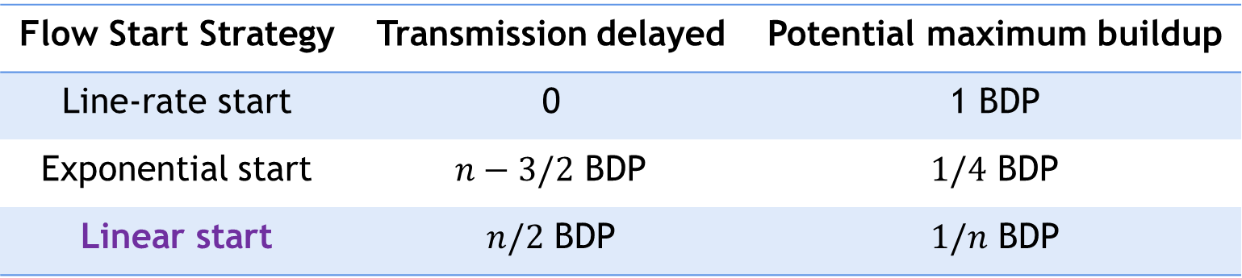
PrioPlus Design: Linear Start
DCN CCs’ solution: start at the line rate.
Internet CCs’ solution: start at a low rate and accelerate exponentially.
PrioPlus’s solution: start at a low rate and accelerate linearly until the delay is larger than the base RTT.
Flow Start Strategy | Transmission delayed | Potential maximum buildup
Line-rate start | 0 | 1 BDP
Exponential start | $n−3/2$ BDP | $1/4$ BDP
Linear start | $n/2$ BDP | $1/n$ BDP
See our paper for the detailed analysis.

Slide 27




PrioPlus Design: Linear Start
Linear start effectively balances transmission delayed and maximum potential queue buildup.
Flow Start Strategy | Transmission delayed | Potential maximum buildup
Line-rate start | 0 | 1 BDP
Exponential start | $n−3/2$ BDP | $1/4$ BDP
Linear start | $n/2$ BDP | $1/n$ BDP
Linear start is the start strategy that incurs the least potential buffer backlog when increasing the send rate from 0 to the line rate in a given period.
See our paper for the formal proof.

Slide 28
PrioPlus’s Workflow
High-priority flow
Low-priority flow
Delay
$D_{target}$ of
high priority
$D_{target}$ of
low priority
Linear start
Time
Rate
Finish
Dual-RTT adaptive increase
Probe
Start
Time

Slide 29
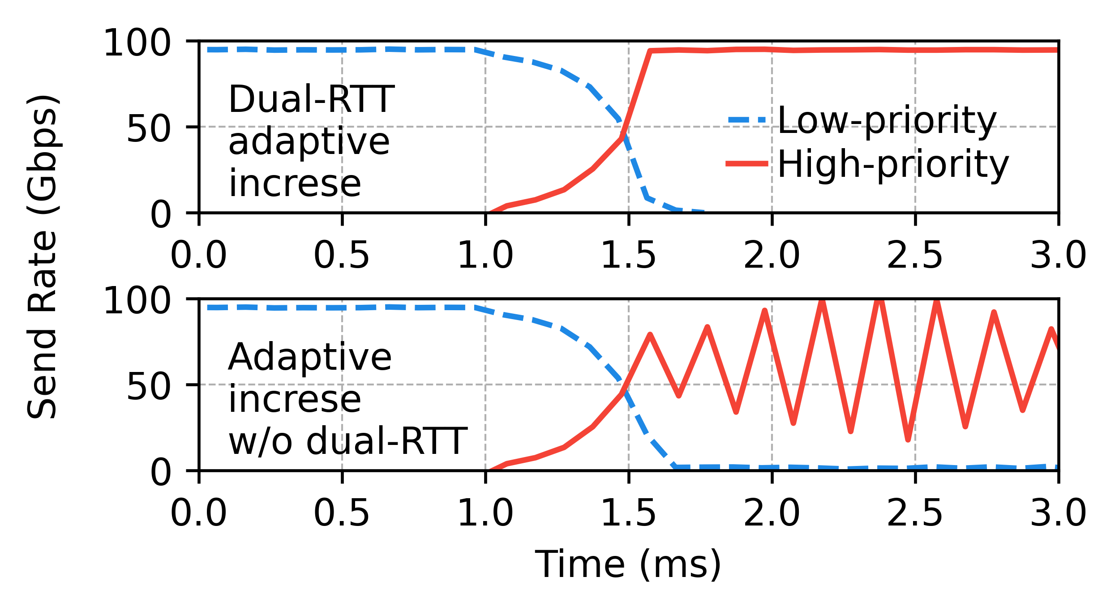
PrioPlus Design: Dual-RTT Adaptive Increase
When delay below the given delay channel, a PrioPlus flow will raise the delay to its delay channel precisely using dual-RTT adaptive increase.
See our paper for the detailed design and analysis.

Slide 30

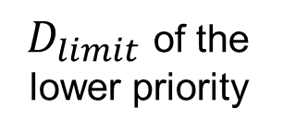

Compress and Configure the PrioPlus Channel Width
The channel width must accommodate CC’s normal fluctuations and the noise in the delay measurement.
Thresholds
Actual delay
Noise range
Delay
$$D_{limit}$$
Noise in delay
measurement
Channel
$$D_{target}$$
width of
this priority
CC's
fluctuations
$D_{limit}$ of the
lower priority
Time

Slide 31
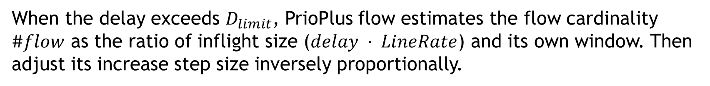
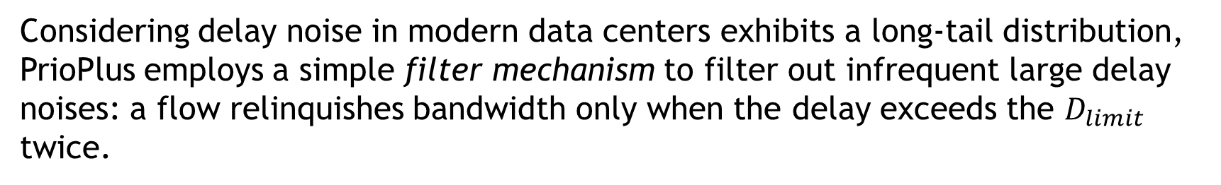
Compress and Configure the PrioPlus Channel Width
Compress CC’s fluctuations.
When the delay exceeds $D_{limit}$, PrioPlus flow estimates the flow cardinality $\#flow$ as the ratio of inflight size ($delay · LineRate$) and its own window. Then adjust its increase step size inversely proportionally.
Accommodate the delay noise
Considering delay noise in modern data centers exhibits a long-tail distribution, PrioPlus employs a simple filter mechanism to filter out infrequent large delay noises: a flow relinquishes bandwidth only when the delay exceeds the $D_{limit}$ twice.
See our paper on how to determine CC’s fluctuations and delay noise in different network environments and set channel width accordingly.

Slide 32
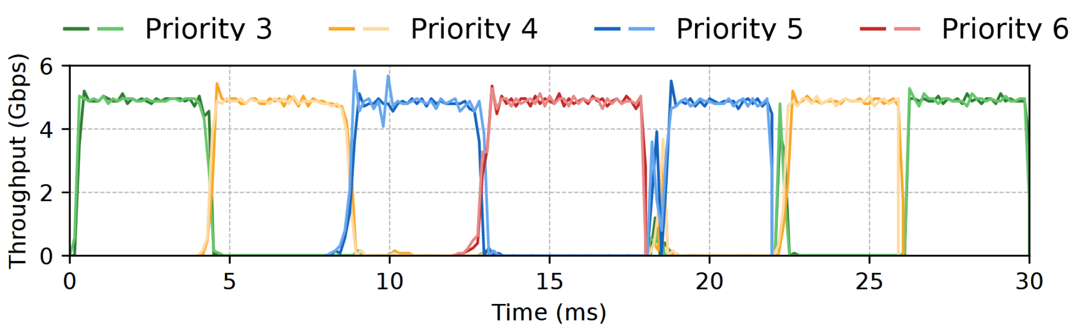
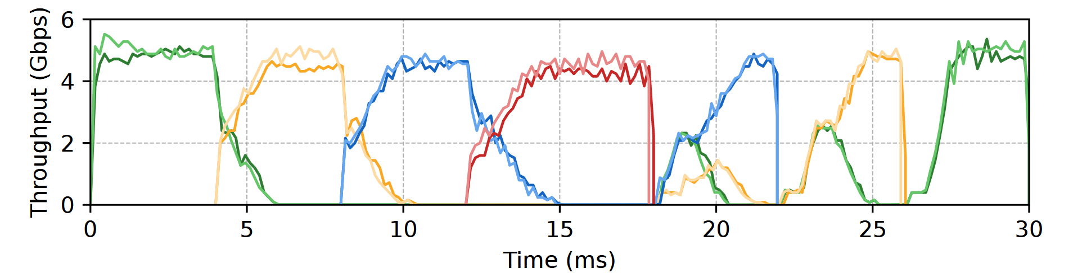
Testbed Evaluation
Implement PrioPlus on Swift’s DPDK implementation using 79 LoCs.
Topology: a 10 Gbps tree topology with four leaves are senders and the root is the receiver.
Channel width: 4 us.
PrioPlus + Swift:
Swift:

Slide 33
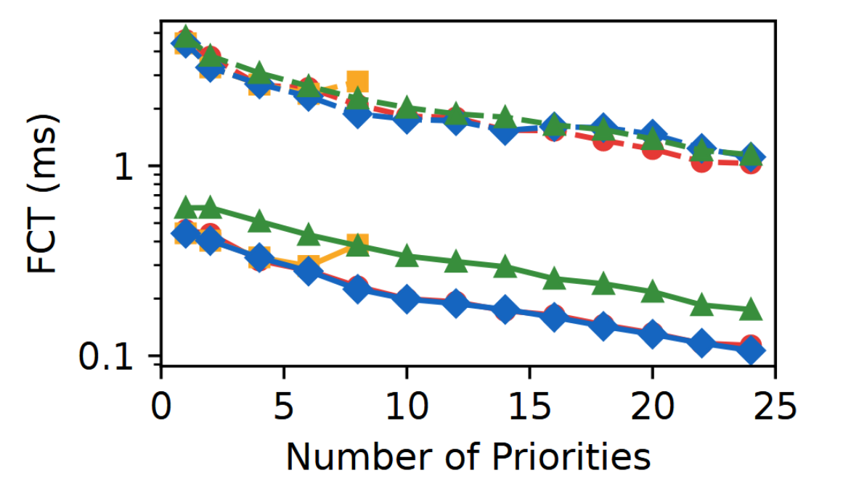
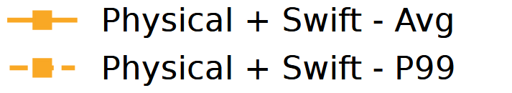
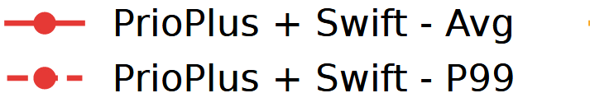
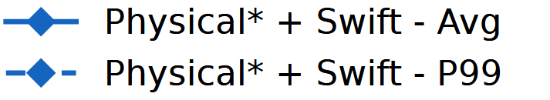
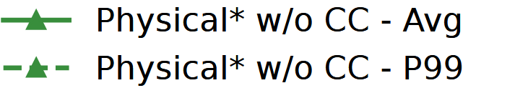
Simulation Evaluation
Flow scheduling scenario: The performance of PrioPlus with Swift closely approaches ideal physical priority with Swift, with average FCT being at most 8% worse.
Topology: stranded fat-tree with k=6. Workload: WebSearch. Channel width: 4 us.
Buffer: 4.4 MB/Tbps, aligned with the latest switch.

Slide 34
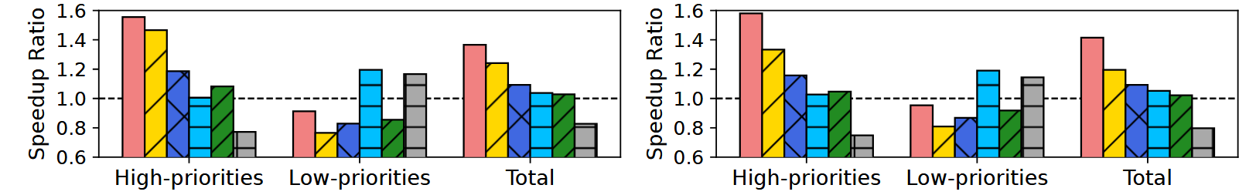
Simulation Evaluation
Coflow scheduling scenario: When the load is at 40%/70%, the average speedup ratio of PrioPlus with Swift is 12%/21% higher than that of physical priority with Swift.
Topology: fat-tree with 320 hosts. Workload: Facebook Hadoop trace. Channel width: 4 us.
Buffer: 32 MB to avoid insufficient buffer impacting the performance of physical priorities.
Coflow scenario at 40% load.
Coflow scenario at 70% load.
See our paper for evaluations on incast, noise robustness,model training and so on…

Slide 35
Conclusion
PrioPlus is a congestion control enhancement algorithm designed to integrate with existing delay-based CC mechanisms, enabling multiple virtual priorities within each physical queue in data centers.
It is lightweight, requiring fewer than 100 lines of code modifications to existing CC implementations.
Find our open-source code with a one-click script to reproduce our results on:
https://github.com/NASA-NJU/PrioPlus

