Slide 1





OSCAR: O(1)-Step Convergence And Readily-deployable Congestion Control
Zhaochen Zhang, Feiyang Xue, Rui Ning, Keqiang He, Gianni Antichi, Jiaqi Gao, Zhimeng Yin, Kexin Liu, Rui Li, Zhengqi Cui, Zhehao Lin, Peirui Cao, Guihai Chen, Chen Tian
Notes:
Good afternoon everyone. I'm Chen Tian from Nanjing University. Today I’m glad to present OSCAR — to our knowledge, the first congestion control algorithm that achieves O(1)-step convergence while being readily deployable on commodity datacenter hardware.

Slide 2
CC’s Convergence Speed Matters
Trend1:
Workloads like AI training and inference exhibit frequent on-off traffic patterns.
Rate
Initial state of on-phase
Target state
Frequent convergence processes.
Queue buildup
Line Rate
Trend2:
Bandwidth keeps climbing — from 100 Gbps to 800 Gbps.
Under-utilization
Initial state of off-phase
Larger state gap to converge
Time
Notes:
Let's start with the central question of this paper: why does convergence speed matter so much today?
Two trends. First, modern datacenter workloads like AI training and inference exhibit frequent on-off traffic patterns.
###So the network constantly goes through "on" and "off" phases, and the congestion control has to re-converge again and again.
###Second, link bandwidth keeps climbing — from 100 Gbps to 200, 400, even 800 Gbps.
###The faster the link, the larger the gap a CC has to close every time it converges.

Slide 3
CC’s Convergence Speed Matters
Trend1:
Workloads like AI training and inference exhibit frequent on-off traffic patterns.
Rate
Initial state of on-phase
More queue buildup
Target state
Frequent convergence processes.
Line Rate
Trend2:
Bandwidth keeps climbing — from 100 Gbps to 800 Gbps.
More under-utilization
Larger state gap to converge
Initial state of off-phase
Time
Notes:
(The faster the link, the larger the gap a CC has to close every time it converges.)
Together, these two trends mean: more frequent convergence processes, each one bigger. If your CC is slow, you pay it back twice — more queue buildup during the "on" phase, more under-utilization during the "off" phase. So today, it's not enough to ask "what state does the CC eventually converge to?" — we also have to ask "how fast does it get there?" Convergence speed is just as important as the converged state itself.

Slide 4
CC’s Convergence Speed Matters
We borrow big-O notation to describe CC’s convergence speed
Rate
Initial state of on-phase
Common Algorithms | Congestion Control
Input size n | State gap Δ
Time cost | # of update steps
O(n),O(log n),O(1) | O(Δ),O(log Δ),O(1)
Δ
Target state
Line Rate
# of update steps
Initial state of off-phase
O(1) = converges in constant # of steps, regardless of how big the gap is.
Time
Notes:
To measure convergence speed, we borrow big-O notation from algorithmic complexity. We let Δ denote the state gap between the current and target state — analogous to "input size" in time complexity. Then a CC's convergence speed is just how many update steps it takes to close Δ.
Among all classes of CCs, the best one is O(1)-step convergence CC. It means the CC reaches the target in a constant number of steps, regardless of how big the gap is. That's the property you need to achieve predictable performance under any network dynamics.

Slide 5
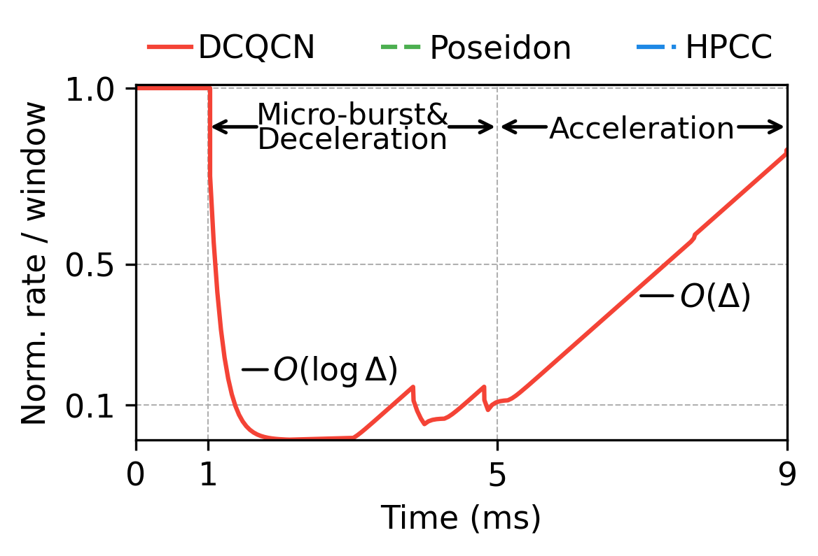
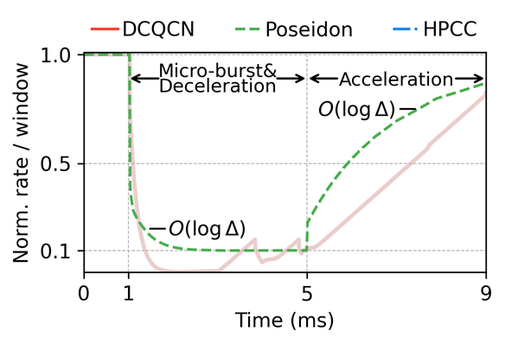
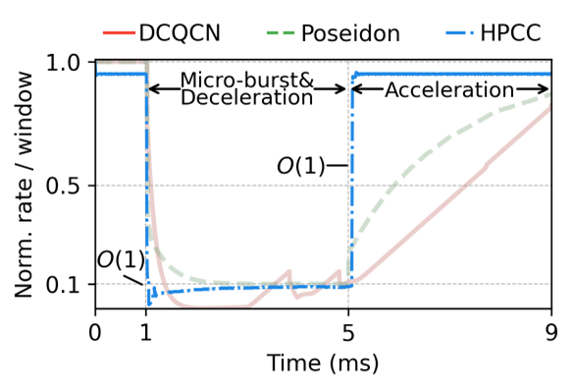
CCs Have Different Convergence Speeds
A micro-benchmark shows convergence speeds
Setup: 1 long flow + 9 short flows form a microburst (1ms–5ms).
Y-axis: the long flow's rate/window, normalized to link capacity.
Notes:
CCs Have Different Convergence Speeds. Here's a micro-benchmark to show how typical CCs converge. In the experiment one long flow plus nine short flows from 1 ms to 5 ms. The y-axis is the long flow's rate or window, normalized to link capacity. The three behaviors are very clear. DCQCN is O(log Δ) during deceleration and O(Δ) during acceleration.
###Poseidon is O(log Δ) during both stages.
###HPCC is O(1), which lands on the target super quickly.

Slide 6
CCs Have Different Convergence Speeds
Category
Sender-driven | AIMD-based
 | Short-INT-based
 | Precise-INT-based
Receiver-driven
Switch-driven
Representative CCs
DCQCN, TIMELY, Swift
Poseidon
HPCC, PowerTCP
NDP, Homa
XCP, Bolt, Harmony
Acceleration | Deceleration
O(Δ) | O(log Δ)
O(log Δ) | O(log Δ)
O(1) | O(1)
O(1) | O(1)
O(1) | O(1)
Three types of CCs can achieve O(1)-step convergence!
Notes:
We surveyed existing datacenter CCs and grouped them by their convergence behavior.
###Three categories already deliver O(1) — precise-INT-based, receiver-driven, and switch-driven. All three are great in performance. But…

Slide 7
Current O(1)-step CCs Are Not Deployment-Friendly
Category
Sender-driven | AIMD-based
 | Short-INT-based
 | Precise-INT-based
Receiver-driven
Switch-driven
Representative CCs
DCQCN, TIMELY, Swift
Poseidon
HPCC, PowerTCP
NDP, Homa
XCP, Bolt, Harmony
Acceleration | Deceleration
O(Δ) | O(log Δ)
O(log Δ) | O(log Δ)
O(1) | O(1)
O(1) | O(1)
O(1) | O(1)
[1]
Lengthy INT headers are hard to deploy on high-speed hardware !
[1] (NSDI23) Poseidon: Efficient, robust, and practical datacenter CC via deployable INT.
Notes:
Precise-INT-based CCs like HPCC and PowerTCP need an in-band lengthy INT header, which is hard to deploy on high-speed hardware in practice.

Slide 8
Current O(1)-step CCs Are Not Deployment-Friendly
Category
Sender-driven | AIMD-based
 | Short-INT-based
 | Precise-INT-based
Receiver-driven
Switch-driven
Representative CCs
DCQCN, TIMELY, Swift
Poseidon
HPCC, PowerTCP
NDP, Homa
XCP, Bolt, Harmony
Acceleration | Deceleration
O(Δ) | O(log Δ)
O(log Δ) | O(log Δ)
O(1) | O(1)
O(1) | O(1)
O(1) | O(1)
[1]
Packet spraying is poorly supported by legacy RDMA NICs .
Topology assumptions do not always hold .
[2]
[1] (SIGCOMM25) Falcon [2](SIGCOMM24) Alibaba HPN
Notes:
Receiver-driven and switch-driven CCs depend on packet spraying, which is poorly supported by legacy RDMA NICs. And their symmetric, well-provisioned topology assumption often doesn't hold either — production fabrics like Alibaba HPN use oversubscription to scale, and frequent link failures further break symmetry in practice.

Slide 9
Current O(1)-step CCs Are Not Deployment-Friendly
Category
Sender-driven | AIMD-based
 | Short-INT-based
 | Precise-INT-based
Receiver-driven
Switch-driven
Representative CCs
DCQCN, TIMELY, Swift
Poseidon
HPCC, PowerTCP
NDP, Homa
XCP, Bolt, Harmony
Acceleration | Deceleration
O(Δ) | O(log Δ)
O(log Δ) | O(log Δ)
O(1) | O(1)
O(1) | O(1)
O(1) | O(1)
Commodity switches can not support such computational capabilities.
Notes:
Switch-driven CCs like XCP, Bolt, and Harmony need computation on the switch, which is not supported by commodity switches.

Slide 10
Current O(1)-step CCs Are Not Deployment-Friendly
Category
Sender-driven | AIMD-based
 | Short-INT-based
 | Precise-INT-based
Receiver-driven
Switch-driven
Representative CCs
DCQCN, TIMELY, Swift
Poseidon
HPCC, PowerTCP
NDP, Homa
XCP, Bolt, Harmony
Acceleration | Deceleration
O(Δ) | O(log Δ)
O(log Δ) | O(log Δ)
O(1) | O(1)
O(1) | O(1)
O(1) | O(1)
Can a readily deployable CC
achieve O(1)-step convergence?
Commodity switches can not support such computational capabilities.
Notes:
So we're left with a clean question: can a readily deployable CC also achieve O(1)-step convergence?

Slide 11
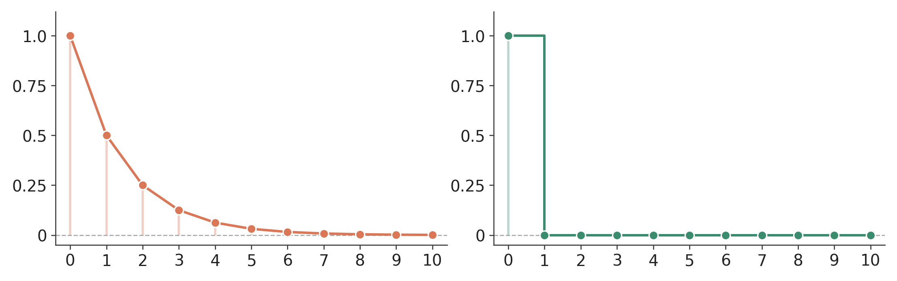
O(1)-step Boils Down to One-step Convergence
Convergence in O(1) steps needs at least one of these steps can eliminate the entire remaining gap (one-step convergence).
If each step closes a fraction (50%).
If at least one step closes Δ entirely.
Remaining gap
# of update steps
# of update steps
Notes:
Our answer is yes. To see how, we first need to sharpen what O(1)-step convergence actually demands.
If every step closes only a fraction of Δ, you're stuck with at least O(log Δ) steps. So to actually get O(1), at least one step has to close the entire remaining gap.
In other words, O(1)-step convergence really boils down to one-step convergence.
So the question becomes: how do we make a single step close Δ entirely?

Slide 12
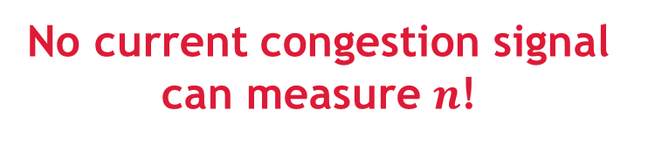
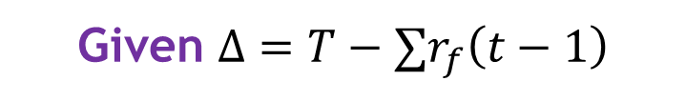
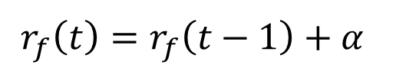
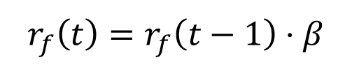
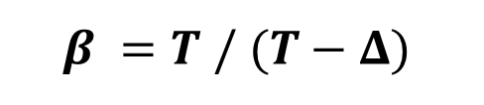
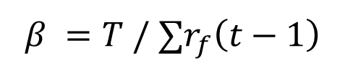
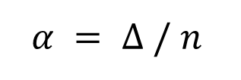


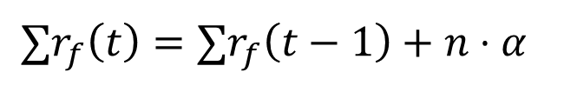

Principle 1: MIMD over Precise Signals is Essential
AI
MI
A single flow’s update
A single flow’s update
$$r_{f}\left(t\right)=r_{f}\left(t−1\right)⋅β$$
$$r_{f}\left(t\right)=r_{f}\left(t−1\right)+α$$
Agg. rate of $n$ flows
Agg. rate of $n$ flows
$${∑r}_{f}\left(t\right)={∑r}_{f}\left(t−1\right)⋅β$$
$${∑r}_{f}\left(t\right)={∑r}_{f}\left(t−1\right)+n⋅α$$
To eliminate the gap ∆
$$β =T /{ ∑r}_{f}\left(t−1\right)$$
To eliminate the gap ∆
$$α = Δ / n$$
Given $Δ=T−{∑r}_{f}\left(t−1\right)$
$$β =T / (T−Δ)$$
✓
No current congestion signal can measure $n$!
T is known previously
∆ can be measured from signals
Notes:
We start with Principle 1: MIMD reaction to precise signals is essential. The justification is structural rather than empirical.
Look at the AI update for n flows competing on a bottleneck.
###The aggregate rate after one AI step is the previous aggregate plus n times α.
###To eliminate the gap Δ in a single step, you'd need α to equal Δ / n.
###But there's a problem — n is the number of competing flows, and no end-to-end congestion signal can measure n. So AI is structurally incapable of one-step convergence.
Now look at MI.
###The aggregate after MI is the previous aggregate times β.
###The β you need is just rate target divided by (rate target minus Δ).
###The rate target is known by design, and Δ can be measured from congestion signals.
So β is computable — and one-step convergence is reachable.
And this is exactly what HPCC does. Which is also exactly why HPCC needs INT: INT is what gives HPCC the precise Δ for that β.
But the whole point of this work is to do it without INT. So the next question becomes: is there any end-to-end signal precise enough to take INT's place?

Slide 13
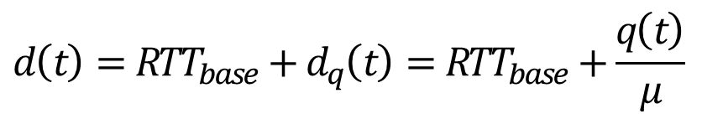
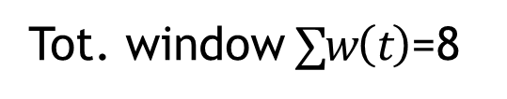

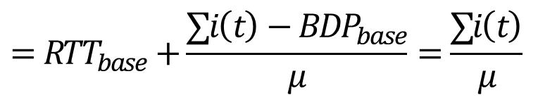
Principle 2: Delay & Delay Gradient as Precise Signals
Analytical Formulation
Visual Illustration
Sender1’s
window
$$d\left(t\right)=RTT_{base}+d_{q}\left(t\right)=RTT_{base}+\frac{q\left(t\right)}{μ}$$
$$=RTT_{base}+\frac{∑i\left(t\right)−BDP_{base}}{μ}=\frac{∑i\left(t\right)}{μ}$$
S2’s win.
Receiver
$$≤\frac{∑w\left(t\right)}{μ}$$
Bottleneck
queue
Tot. window $∑w\left(t\right)$=8
Notes:
Our answer is: delay and delay gradient can serve as precise signals — but only under specific conditions. Let me show you why.

Slide 14
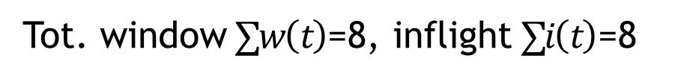
Principle 2: Delay & Delay Gradient as Precise Signals
Analytical Formulation
Visual Illustration
Sender1’s
window
$$d\left(t\right)=RTT_{base}+d_{q}\left(t\right)=RTT_{base}+\frac{q\left(t\right)}{μ}$$
$$=RTT_{base}+\frac{∑i\left(t\right)−BDP_{base}}{μ}=\frac{∑i\left(t\right)}{μ}$$
S2’s win.
Receiver
$$≤\frac{∑w\left(t\right)}{μ}$$
Bottleneck
queue
Tot. window $∑w\left(t\right)$=8, inflight $∑i\left(t\right)$=8
Notes:
Our answer is: delay and delay gradient can serve as precise signals — but only under specific conditions. Let me show you why.

Slide 15
Principle 2: Delay & Delay Gradient as Precise Signals
Analytical Formulation
Visual Illustration
Queueing delay
Sender1’s
window
$$d\left(t\right)=RTT_{base}+d_{q}\left(t\right)=RTT_{base}+\frac{q\left(t\right)}{μ}$$
$$=RTT_{base}+\frac{∑i\left(t\right)−BDP_{base}}{μ}=\frac{∑i\left(t\right)}{μ}$$
S2’s win.
Receiver
$$≤\frac{∑w\left(t\right)}{μ}$$
Base RTT
Notes:
The derivation is simple. First delay equals base RTT plus queueing delay.

Slide 16
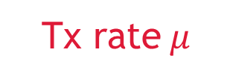
Principle 2: Delay & Delay Gradient as Precise Signals
Analytical Formulation
Visual Illustration
Queueing packets
Sender1’s
window
$$d\left(t\right)=RTT_{base}+d_{q}\left(t\right)=RTT_{base}+\frac{q\left(t\right)}{μ}$$
$$=RTT_{base}+\frac{∑i\left(t\right)−BDP_{base}}{μ}=\frac{∑i\left(t\right)}{μ}$$
S2’s win.
Receiver
$$≤\frac{∑w\left(t\right)}{μ}$$
Tx rate $μ$
Notes:
The queueing delay can be calculated as queue length divided by transmit rate at the bottleneck.

Slide 17
Principle 2: Delay & Delay Gradient as Precise Signals
Analytical Formulation
Visual Illustration
Eq. holds when the queue is not empty
Sender1’s
window
$$d\left(t\right)=RTT_{base}+d_{q}\left(t\right)=RTT_{base}+\frac{q\left(t\right)}{μ}$$
$$=RTT_{base}+\frac{∑i\left(t\right)−BDP_{base}}{μ}=\frac{∑i\left(t\right)}{μ}$$
S2’s win.
Receiver
$$≤\frac{∑w\left(t\right)}{μ}$$
Base BDP
Notes:
The queue length then equals total inflight minus base BDP — only when the queue is not empty.

Slide 18
Principle 2: Delay & Delay Gradient as Precise Signals
Analytical Formulation
Visual Illustration
Sender1’s
window
$$d\left(t\right)=RTT_{base}+d_{q}\left(t\right)=RTT_{base}+\frac{q\left(t\right)}{μ}$$
$$=RTT_{base}+\frac{∑i\left(t\right)−BDP_{base}}{μ}=\frac{∑i\left(t\right)}{μ}$$
S2’s win.
Receiver
$$≤\frac{∑w\left(t\right)}{μ}$$
Equality holds when window-bounded
Tot. window $∑w\left(t\right)$=8, inflight $∑i\left(t\right)$=8
Notes:
And inflight equals total window — only when flows are window-bounded.

Slide 19
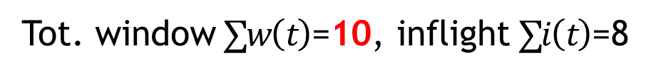
Principle 2: Delay & Delay Gradient as Precise Signals
Analytical Formulation
Visual Illustration
Sender1’s
window
$$d\left(t\right)=RTT_{base}+d_{q}\left(t\right)=RTT_{base}+\frac{q\left(t\right)}{μ}$$
$$=RTT_{base}+\frac{∑i\left(t\right)−BDP_{base}}{μ}=\frac{∑i\left(t\right)}{μ}$$
S2’s win.
Receiver
$$≤\frac{∑w\left(t\right)}{μ}$$
Equality holds when window-bounded
Tot. window $∑w\left(t\right)$=10, inflight $∑i\left(t\right)$=8
Notes:
If flows are not window-bounded, the window sizes will be larger than the inflight packet counts.

Slide 20
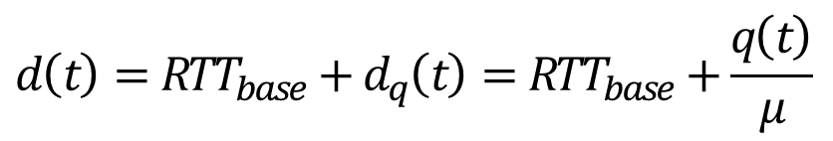

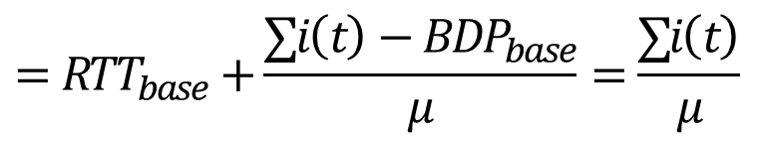
Principle 2: Delay & Delay Gradient as Precise Signals
Precise congestion state can be extracted from delay!
Analytical Formulation
Visual Illustration
Sender1’s
window
$$d\left(t\right)=RTT_{base}+d_{q}\left(t\right)=RTT_{base}+\frac{q\left(t\right)}{μ}$$
$$=RTT_{base}+\frac{∑i\left(t\right)−BDP_{base}}{μ}=\frac{∑i\left(t\right)}{μ}$$
S2’s win.
Receiver
$$≤\frac{∑w\left(t\right)}{μ}$$
The total window size of flows passing through the bottleneck
Notes:
Therefore, under specific conditions, delay precisely reflects the aggregate window of flows through the bottleneck. Not approximately — exactly.

Slide 21


Principle 2: Delay & Delay Gradient as Precise Signals
Similarly, an analogous relationship holds for the delay gradient
(Please see our paper for details on the delay gradient)
Delay — Window
Delay gradient — Rate
$$d\left(t\right)≤\frac{∑w\left(t\right)}{μ}$$
$$g\left(t\right)≤\frac{∑r\left(t\right)}{μ}−1$$
Equality holding when the queue is neither empty nor overflowing, and flows are bounded by window.
Equality holding when the queue is neither empty nor overflowing, and flows are bounded by rate.
The two signals are precise under mutually exclusive conditions
Therefore, they should be used complementarily
Notes:
An analogous derivation — which I'll skip in the interest of time, it's in the paper — shows that delay gradient precisely reflects the total send rate, but under a different condition: when flows are rate-bounded, not window-bounded.
###Now notice the catch: a flow can‘t be window-bounded and rate-bounded at the same time. So the two signals are precise under mutually exclusive conditions, and neither signal alone is sufficient.
###The fix is to use them complementarily. Together, they could give you INT-level precision from purely end-to-end measurements.

Slide 22







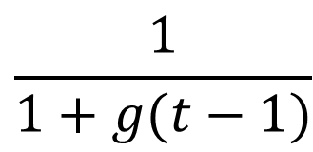


OSCAR: O(1)-Step Convergence And Readily-deployable
OSCAR has a simple control law
$$\frac{D_{target}}{d(t−1)}$$
$$w\left(t\right)$$
$$=$$
$$·$$
$$w\left(t−1\right)$$
$$\frac{1}{1+g(t−1)}$$
$$r\left(t\right)$$
$$=$$
$$·$$
$$r\left(t−1\right)$$
Notes:
Combining the two principles gives OSCAR's core control law.
One loop uses delay to control the window — driving the measured delay toward our target delay. Given the relationship between delay and aggregate window we stated before, the target delay can be also considered as a target window. Similarly, the other loop uses the delay gradient to control the rate — driving the aggregate ingress rate at the bottleneck to match the line rate.
Theoretically, both loops could converge in a single step under idealized conditions.

Slide 23







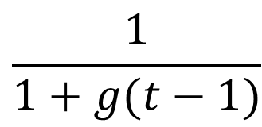


OSCAR: O(1)-Step Convergence And Readily-deployable
OSCAR has a simple control law
, and four novel technical challenges.
How to calculate congestion signals precisely?
How to select the reference state for updates?
$$\frac{D_{target}}{d(t−1)}$$
$$w\left(t\right)$$
$$=$$
$$·$$
$$w\left(t−1\right)$$
How to avoid conflicts between independent control loops?
$$\frac{1}{1+g(t−1)}$$
$$r\left(t\right)$$
$$=$$
$$·$$
$$r\left(t−1\right)$$
How to make MIMD fair?
Notes:
But to actually realize this control law in practice, we had to solve four novel technical challenges. Let me walk through how we tackled each.

Slide 24
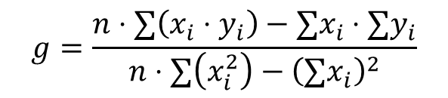

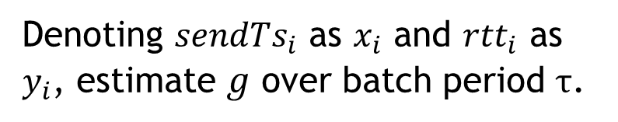
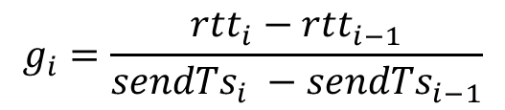

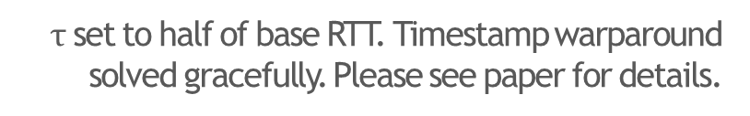
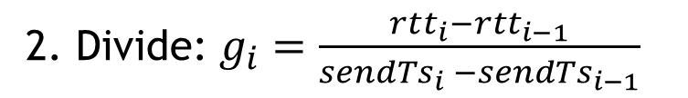
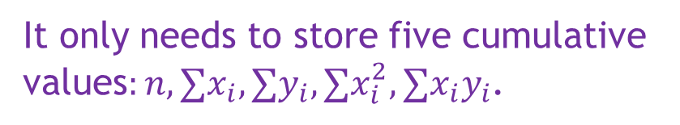
OSCAR Design 1: Batched Least Square
Naive: divide & EWMA
Batched Least Squares (BLS)
1. Record $sendTs_{0…n}$ and ${rtt}_{0…n}$
Denoting $sendTs_{i}$ as $x_{i}$ and ${rtt}_{i}$ as $y_{i}$, estimate $g$ over batch period $τ$.
2. Divide: $g_{i}=\frac{rtt_{i}−rtt_{i−1}}{sendTs_{i} −sendTs_{i−1}}$
3. EWMA: $g=α⋅g+\left(1−α\right)⋅g_{i}$
$$g=\frac{n⋅∑\left(x_{i}⋅y_{i}\right)−∑x_{i}⋅∑y_{i}}{n⋅∑\left(x_{i}^{2}\right)−{\left(∑x_{i}\right)}^{2}}$$
Problem: Noise amplification by small denominator
Constant time and space complexity
$$g_{i}=\frac{rtt_{i}−rtt_{i−1}}{sendTs_{i} −sendTs_{i−1}}$$
It only needs to store five cumulative values$:n,∑x_{i},∑y_{i},∑x_{i}^{2},∑x_{i}y_{i}$.
The interval between packets is at ~10ns level in high-speed network.
$τ$ set to half of base RTT. Timestamp warparound solved gracefully. Please see paper for details.
Notes:
The first challenge is precisely calculating the delay gradient at line rate.
The naive approach — divide the delay difference by the time interval, then smooth with EWMA — fails badly. In a 100 Gbps or higher network, packets interval is around 10 nanoseconds. Dividing a microsecond-scale delay error by a nanosecond-scale time interval amplifies the noise enormously.
###Our solution is Batched Least Squares. Instead of per-packet differences, we treat time as the x-axis and delay as y-axis, and fit a line by least squares over a batch of duration τ. τ is typically set to half the base RTT. The closed-form least-squares solution can be rewritten so that it depends purely on five cumulative sums. So BLS never has to buffer raw. It requires only constant time, constant space — independent of the packet rate.

Slide 25


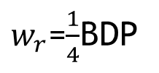
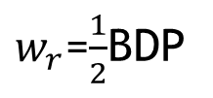
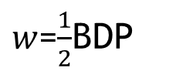

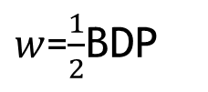
OSCAR Design 2: Reference State Selection
HPCC: reacts to past signal using an unsynchronized state
OSCAR: reacts to signal using the synchronized state that produced it
$w_{r}$=BDP
$w_{r}$=$\frac{1}{2}$BDP
$w_{r}$=$\frac{1}{4}$BDP
$w$=BDP
$w$=BDP
$w$=$\frac{1}{2}$BDP
$w$=$\frac{1}{2}$BDP
half the window
half the window
HPCC's reference state selection
OSCAR's reference state selection
Notes:
The second challenge is choosing the right reference state for the multiplicative update.
HPCC samples a reference window once per RTT. If congestion lasts longer than one RTT, HPCC reacts twice —
###at time RTT, using the state and the congestion signal from time 0;
###then again at time t1 plus RTT, using the state from time RTT and the congestion signal from time t1.
###The result is overreaction: the window is squeezed to ½ BDP, then ¼ BDP, and then it has to oscillate back.
###OSCAR's fix is conceptually simple: always use the state synchronized with the congestion signal you're acting on.
###As shown in the figure, it effectively avoids overreaction.

Slide 26





OSCAR Design 3: Coordinating Two Loops
Theorem: Convergence is only possible when the window and rate are at the same ratio relative to their respective targets. Call that ratio u.
(Please see Theorem 4.1 in paper for details.)
Delay
Unify
$$u_{w}=w/W_{target}$$
$$w=u⋅W_{target}$$
Window
Merge into one ratio
Project back
$$u$$
Gradient
Unify
$$u_{r}=r/R_{target}$$
$$r=u⋅R_{target}$$
Rate
Notes:
The third challenge is coordinating the two loops. They use different congestion signals, different control variables, and different targets — running them naively in parallel will conflict.
###We first prove a theorem in the paper: convergence is feasible only when the window and the rate sit at the same ratio relative to their respective targets. Call that ratio u.
Based on this theorem, OSCAR's coordination is as follow.
###Each loop derives its own u — one from the delay loop, one from the gradient loop —
###we merge them into a single unified u,
###and then project that u back into a concrete window and rate update.
The remaining question is: how do we merge them?

Slide 27


OSCAR Design 3: Coordinating Two Loops
It is impossible to always satisfy the target of both loops simultaneously.
Delay — Window
Sender1’s
window
Flows should decelerate their windows as delay > $D_{target}$
$$D_{target}$$
S2’s win.
Receiver
Delay gradient — Rate
Bottleneck
queue
Flows should keep their rate as delay gradient = 0
Notes:
Before we get to the merge rule, it's worth being explicit: the two targets cannot both be satisfied at the same time.
Here's a typical conflict scenario. Suppose the queue has stabilized, so the delay gradient is already zero. But it has settled above the delay target. The delay-window loop says "delay is too high so shrink the window". However, the gradient-rate loop says "gradient is stable so keep the rate". The two loops disagree.
So we always have to pick a side.

Slide 28
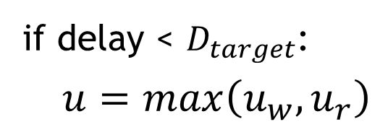
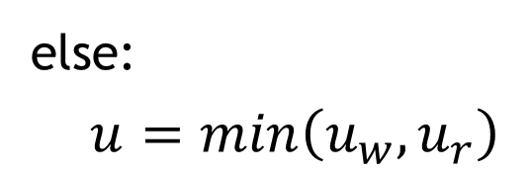
OSCAR Design 3: Coordinating Two Loops
OSCAR selects the ratio based on both direction and magnitude.
Pseudocode
Direction:
OSCAR prioritizes the delay loop's target (queue stability) as gradient loop’s target allows arbitrary queue length.
Accelerating
if delay < $D_{target}$:
$u=max\left(u_{w},u_{r}\right)$
Take the larger
Magnitude:
else:
$u=min\left(u_{w},u_{r}\right)$
Decelerating
Inaccurate signals only shrink magnitude. Therefore OSCAR adopts the larger result of the two loops when accelerating.
Take the smaller
(Please see paper for hyper increase design to avoid under-utilization and the full pseudocode.)
Notes:
How do we pick? OSCAR resolves the conflict along two dimensions — direction and magnitude.
###Direction first. When the two loops disagree on direction, OSCAR follows the delay loop. The reason is that the delay loop's target is a specific delay, which directly keeps the queue bounded. The gradient loop's target allows arbitrary queue length, which is undesirable.
###Then magnitude. Once the direction is fixed, both loops still produce a ratio along that direction, and we have to pick one. Recall what we showed in Principle 2: when those precise conditions don‘t hold, the signal only under-estimates the true gap — never over-estimates it. So when we‘re accelerating, OSCAR takes the larger of the two ratios, because the truth is at least that big, and vice versa.
###OSCAR also includes a hyper-increase design for when the queue is empty and both signals become imprecise. It's rarely triggered in practice — please see the paper for details.

Slide 29
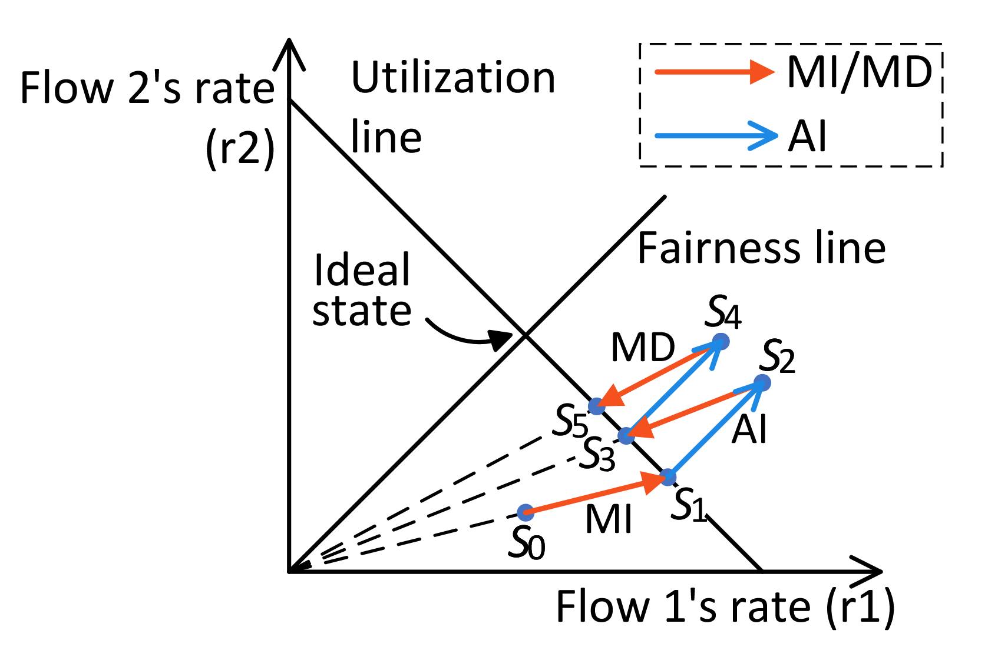
OSCAR Design 4: Ensuring Fairness (optional)
OSCAR adds a small AI term after each MIMD operation, which forms an AIMD cycle around the target and provably converges to fairness.
(Please see paper for details.)
Notes:
The final challenge is MIMD’s famous unfairness. Our fix is straightforward — we add a small constant AI term after each MIMD update. After convergence, this drops OSCAR into a familiar AIMD cycle around the target, which provably converges to fairness.

Slide 30
Implementation and Overhead Evaluation
We implement OSCAR and other CCs for comparison on Linux 5.4.0 with DPDK 25.03 and GCC 8.4 at the highest optimization level. Servers are connected by 40Gbps Links with 13.5 µs base RTT.
Algorithm | OSCAR | DCQCN | Swift | HPCC | PowerTCP
Overhead (CPU cycles) | 52 | 46 | 104 | 92 | 159
OSCAR’s calculation overhead is lower than that of most data center CCs, particularly precise-INT-based CC.
(Please see paper for details of overhead analysis and discussion on RNIC implementation.)
Notes:
We implemented OSCAR in DPDK and evaluated its calculation overhead. The per-ACK calculation cost is 52 CPU cycles. That's lower than HPCC, PowerTCP, and Swift, and comparable to DCQCN.
Our testbed is seven servers connected at 40 Gbps with a 13.5 µs base RTT.

Slide 31
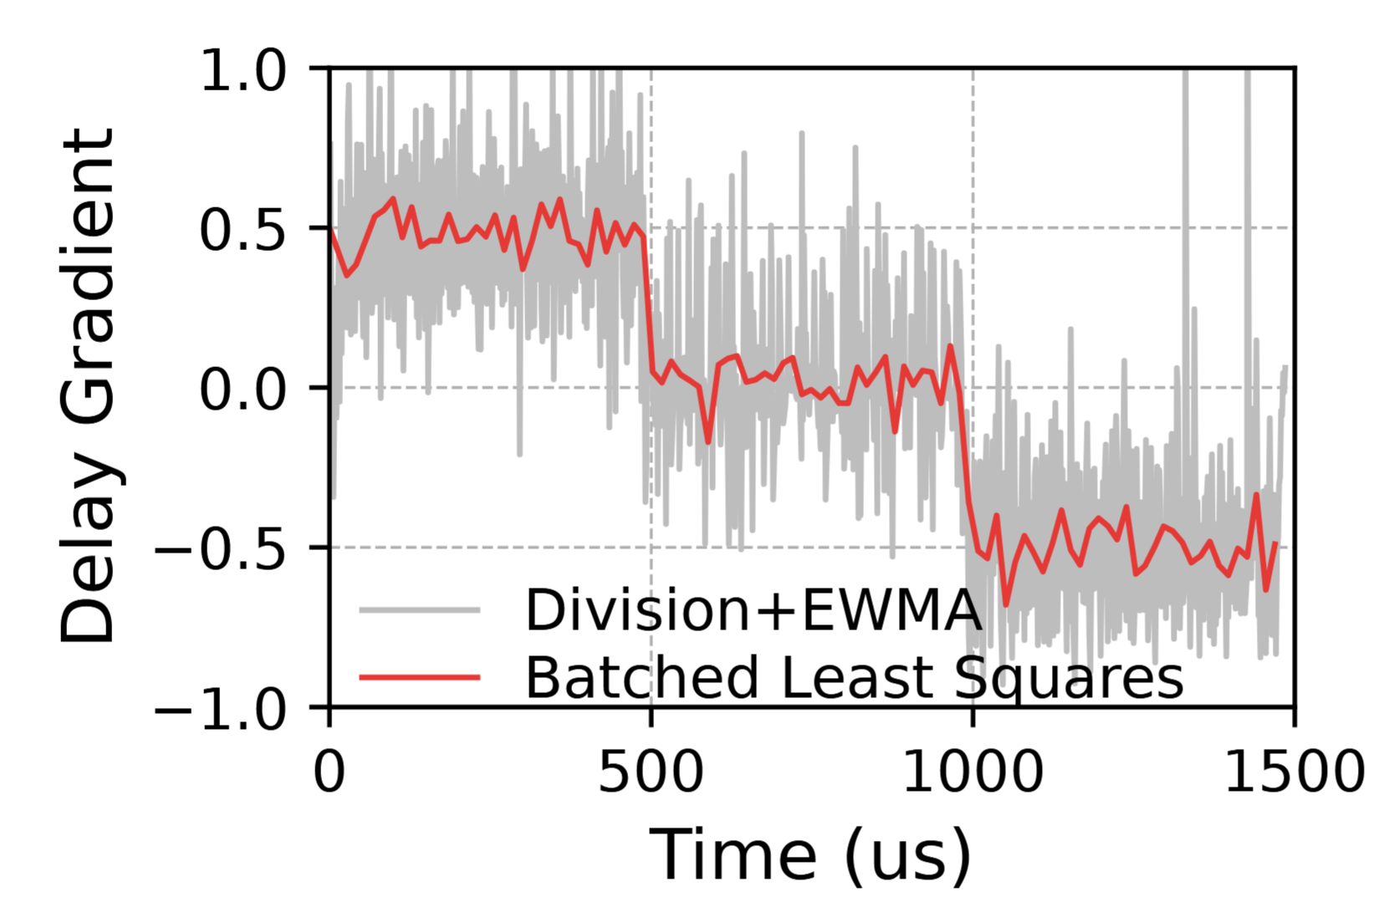
Testbed Evaluation
OSCAR's delay gradient calculation is more precise than Division+EWMA, achieving a Mean Squared Error 13.4× smaller (0.0058 vs. 0.079).
Notes:
First, we validate BLS itself: against the standard division-plus-EWMA approach, BLS achieves 13.4× lower mean squared error in delay-gradient estimation.

Slide 32
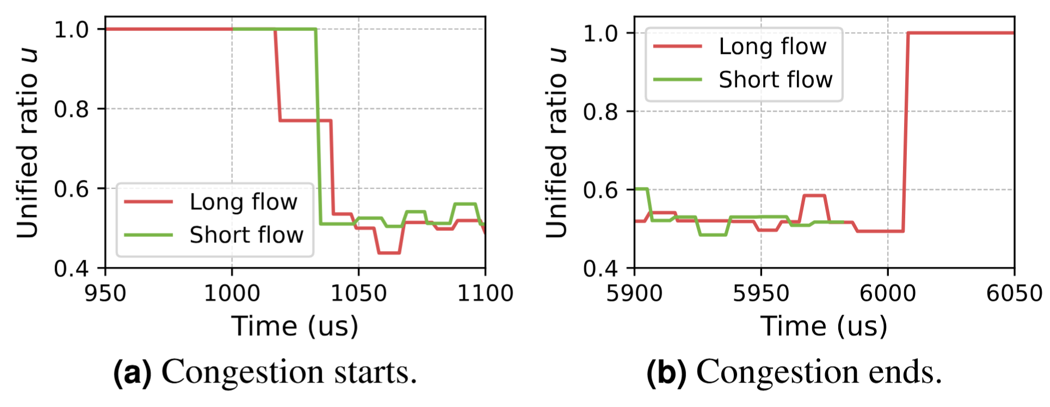
Testbed Evaluation
Microscopic view shows OSCAR can converge in O(1) steps in the testbed.
Notes:
A microscopic view confirms O(1)-step convergence: when congestion starts, the long flow‘s unified ratio drops from 1.0 to its target in one or two updates; when congestion ends, it returns in one update.

Slide 33
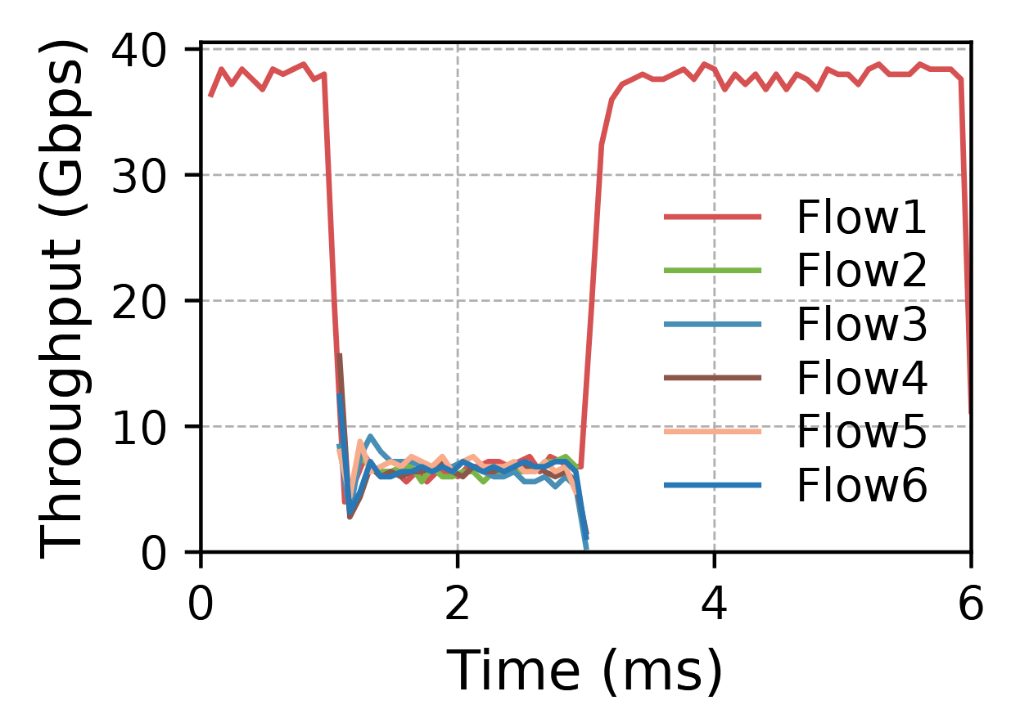
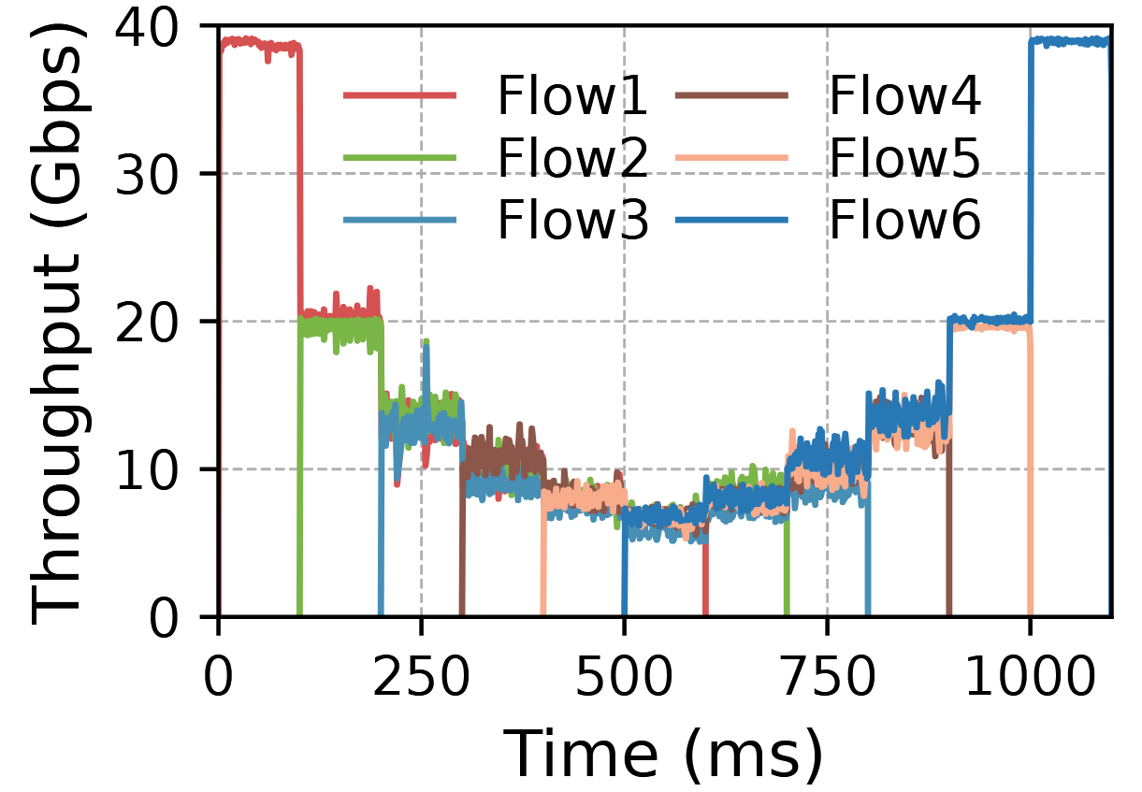
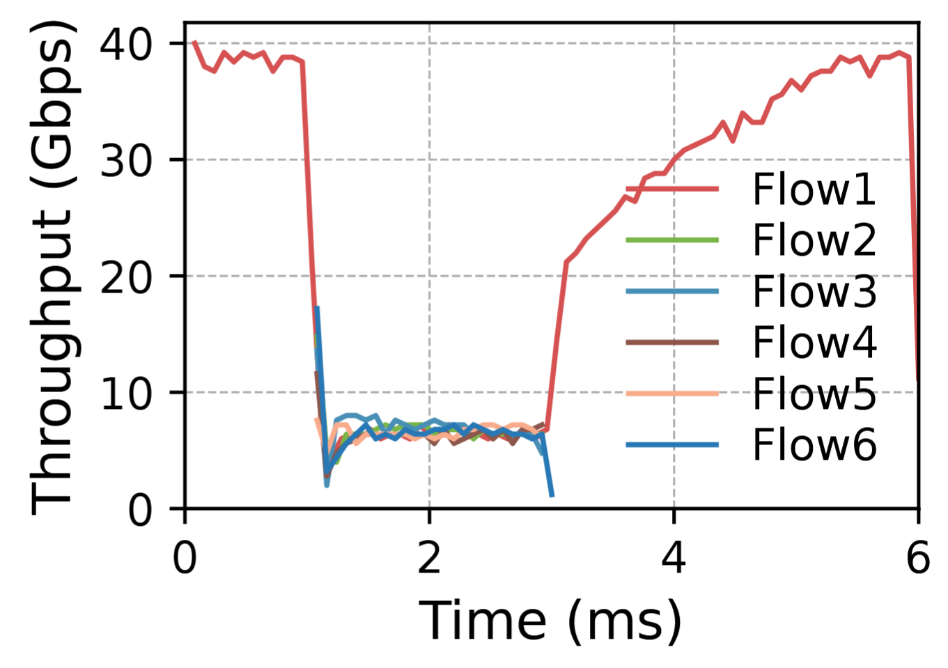
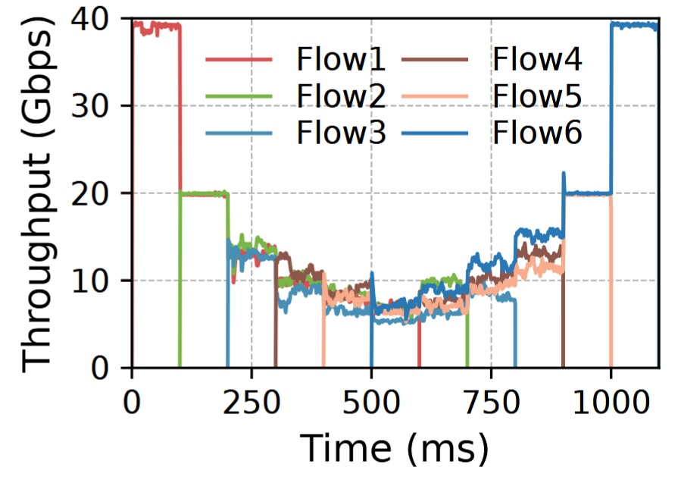
Testbed Evaluation
OSCAR can converge to the target state rapidly and fairly.
OSCAR
SWIFT
Notes:
And here OSCAR converges rapidly and. Compared with Swift on the same setup, OSCAR is both faster and more stable.

Slide 34
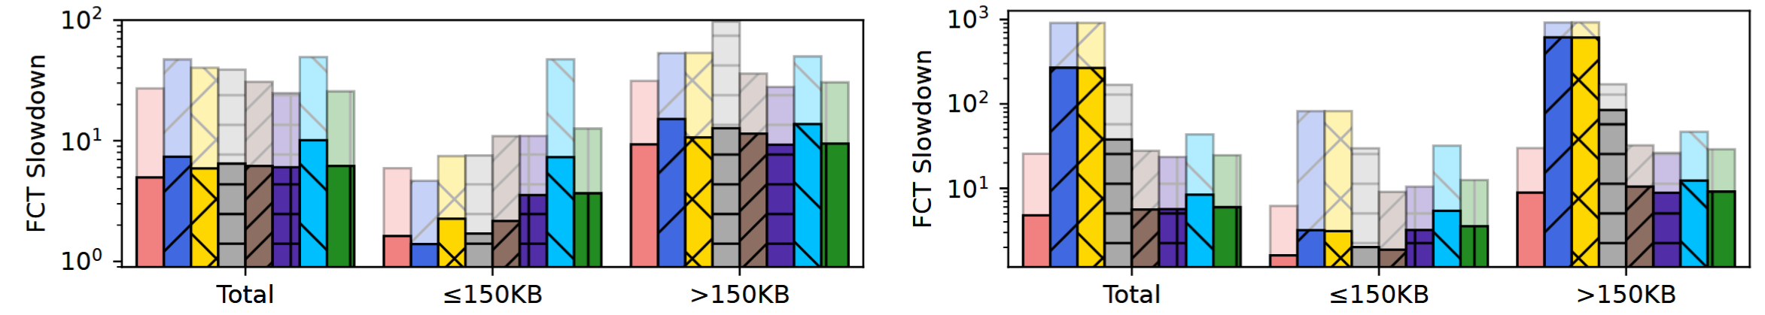
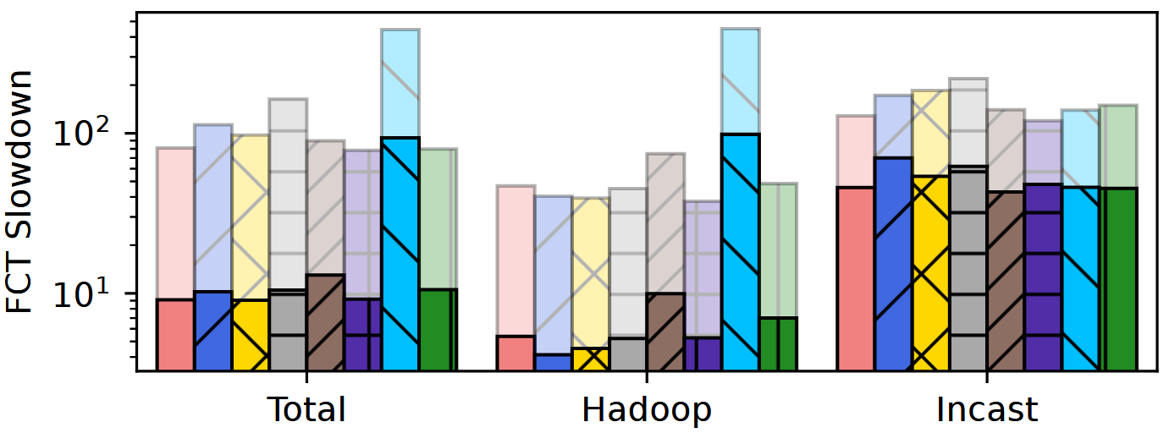
Simulation Evaluation - Standard ECMP Routing
Simulation runs on a 320-host fat-tree in ns-3. FCT slowdown is shown.
Cache Follower
vs HPCC: small flow +7.6%, large flow -62%
avg −48%, tail −74%
vs HPCC* (same target): avg −19%, tail −48%
Hadoop + Incast
vs HPCC: Hadoop +23%, Incast -53%
avg −12%, tail −40%
vs HPCC*: avg matched, tail −21%
CacheFollower at 80% load
Hadoop (50% load) + Incast (20% load)
Notes:
Now to large-scale simulations on a 320-host fat-tree in ns-3.
Under standard ECMP with CacheFollower traffic at 80% load: against HPCC, OSCAR is 7.6% slower on small flows but 62.2% faster on large flows. This trend is similar in Hadoop-incast-mix workload, where OSCAR is 23% slower for smaller Hadoop traffic but 53% faster for incast flows.
Totally, compared with HPCC, OSCAR’s average FCT slowdown is 12%-48% lower and 40%-74% lower at tail.
Against HPCC-star, which is HPCC configured with the same window target as OSCAR — OSCAR still cuts average FCT slowdown by up to 19% and tail by 21%-48%.

Slide 35
Simulation Evaluation - Per-packet Load Balancing
Simulation runs on a 320-host fat-tree in ns-3. FCT slowdown is shown.
Precise-INT-based CCs break as they needs consecutive INTs from the same port.
OSCAR vs others: avg −17% to −76%
CacheFollower at 80% load w/ packet spraying
Notes:
And under per-packet load balancing, which is increasingly used in AI clusters to avoid flow collisions, precise-INT-based CCs fundamentally break, because their congestion signal calculation needs consecutive INTs from the same egress port. OSCAR's batched congestion signal calculation is insensitive to multi-path transmitting, so it works seamlessly — beating every other tested CC by 17 to 76 percent.

Slide 36
Conclusion
OSCAR is the first readily-deployable CC achieving O(1)-step convergence.
Contributions:
Borrowing big-O notation as a new lens to quantify CC convergence speed.
Pinpointing how and when delay & delay gradient can reach INT-level precision.
Novel techniques to realize OSCAR. We believe:
  BLS can serve as a readily-deployable alternative to INT-based monitoring tools.
  Synchronized reference state selection could be a drop-in improvement for existing CCs.
Thanks！
Find our open-source code with a one-click script to reproduce our results at:
https://github.com/NASA-NJU/OSCAR
Notes:
To wrap up. OSCAR is the first readily-deployable CC achieving O(1)-step convergence, by leveraging delay and delay gradient to match INT-level precision.
OSCAR's insight and techniques can extend beyond CC. For instance, BLS can serve as a low-overhead alternative to INT-based network monitoring. It is time to rethink what end-to-end signals can do!
Code, simulator, and one-click reproduction script are all open-source on the GitHub link shown. Thank you — I'm happy to take questions.

