Slide 1



Pyrrha: Congestion-Root-Based Flow Control to Eliminate Head-of-Line Blocking in Datacenter
Kexin Liu*, Zhaochen Zhang*, Chang Liu, Yizhi Wang, Vamsi Addanki, Stefan Schmid, Qingyue Wang, Wei Chen, Xiaoliang Wang, Jiaqi Zheng, Wenhao Sun, Tao Wu, Ke Meng, Fei Chen, Weiguang Wang, Bingyang Liu, Wanchun Dou, Guihai Chen, Chen Tian
Notes:
Hello everyone, this is ________ from Nanjing University.
Today, I am delighted to share with you Pyrrha, which is focused on managing transient congestion using scalable and head-of-line-blocking-free flow control.

Slide 2
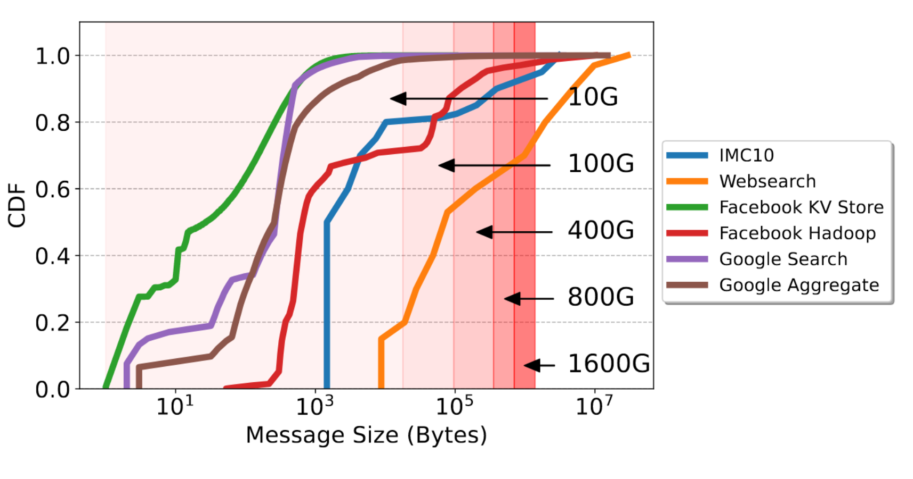
CC is Falling for Transient Congestion
Trend1: The high port bandwidth allows sending out more flows within
the first RTT, even before congestion control could step in.
Flow Size (Bytes)
Figure source: Harmony@NSDI '24
Notes:
With data center networks evolving, there are three trends making congestion control increasingly struggle to manage transient congestion.
The first trend is that as port bandwidth grows, more and more flows can be sent out in the first RTT. Since most congestion controls require one RTT to receive the congestion signal, they cannot manage the transient congestion caused by the first RTT traffic.

Slide 3
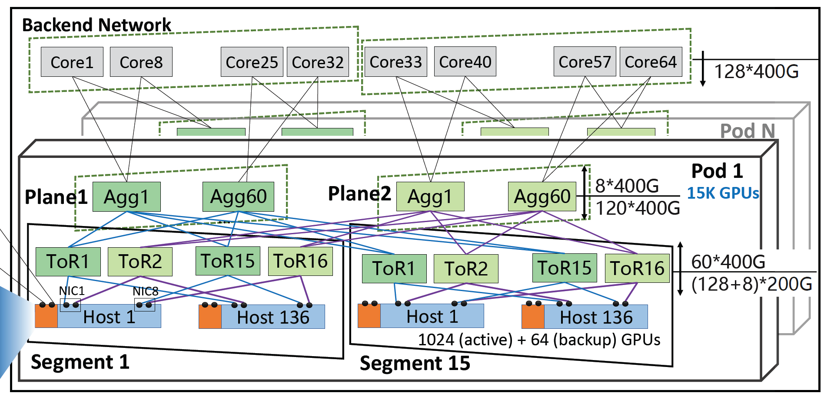
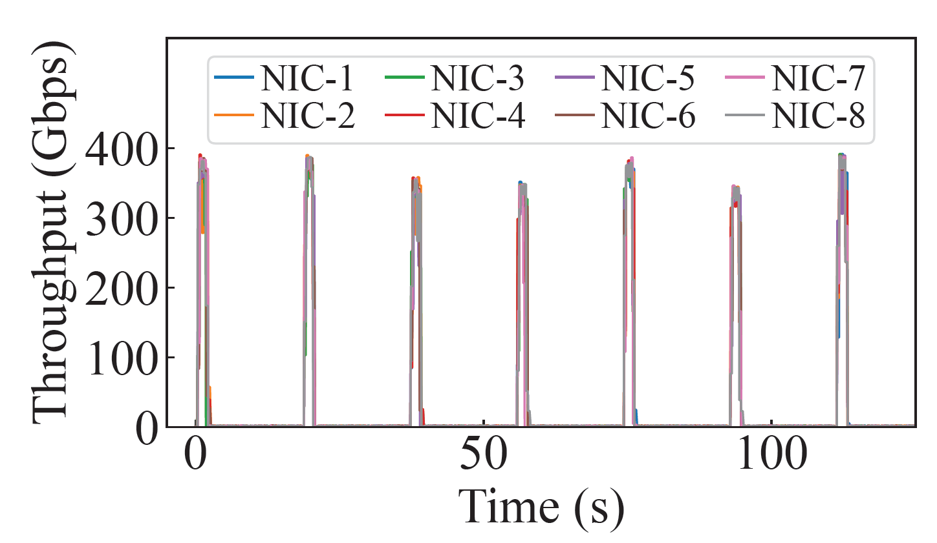
CC is Falling for Transient Congestion
Trend2: The growing scale of DCN and the emerging workloads (e.g., distributed training) lead to more bursty traffic.
Figure source: HPN@Sigcomm ‘24
Notes:
The second trend is that the increasing scale of data center networks and the emergence of workloads such as distributed training will result in more bursty traffic, which means more transient congestion.
// For example, a paper from Alibaba reports its training data center will have fifteen thousand NICs in a pod. And the traffic pattern of each NIC is periodic bursts. This trend may lead to more frequent and larger-scale transient congestion.

Slide 4
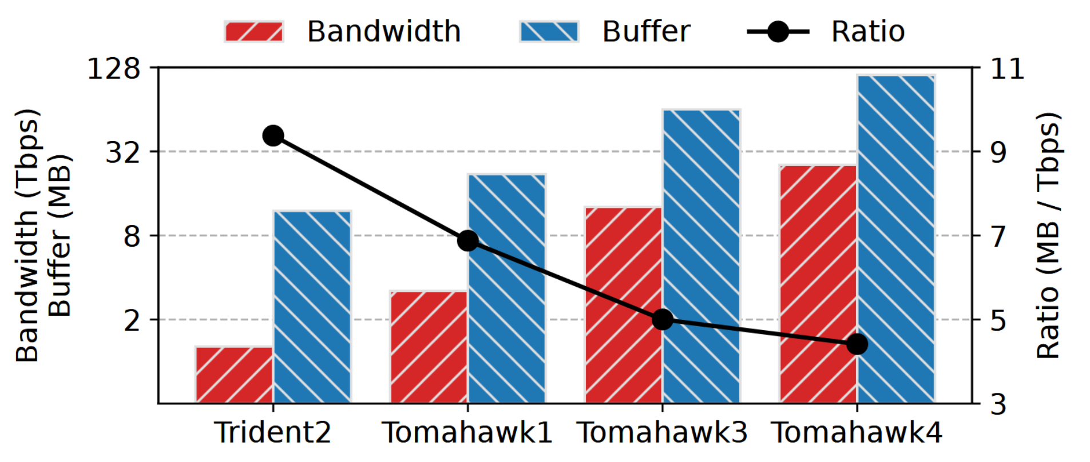
CC is Falling for Transient Congestion
Trend3: The decreasing buffer-to-bandwidth ratio calls for faster congestion management for transient congestion.
Figure source: PrioPlus@EuroSys ‘25
Notes:
The third trend that makes the situation worse is the decreasing buffer-to-bandwidth ratio, which significantly reduces switches’ ability to absorb transient congestion.

Slide 5
CC is Falling for Transient Congestion
Trend3: The decreasing buffer-to-bandwidth ratio calls for faster congestion management for transient congestion.
Data center networks need to manage transient congestion more quickly.
Figure source: PrioPlus@EuroSys ‘25
Notes:
These three trends together demand that data center networks should have an enhanced ability to manage transient congestion more quickly.

Slide 6


Our Vision for Data Center Congestion Management
Per-hop FC handles transient congestion.
End-to-end CC handles persistent congestion.
End-to-end
Congestion
Control
Per-hop Flow Management
Switch
Switch
FC frames
Sender
Receiver
CC signals
Notes:
To solve the transient congestion problem, our vision
⊕ is to leverage per-hop flow control to handle transient congestion.
When applying per-hop flow control, a switch can manage congestion using control frames within a one-hop transmission delay of around one microsecond.
// It is in a unique position to quickly manage flows that have already been injected into the network to avoid performance downgrades.
⊕ And traditional congestion control could be used to adjust flow rates at the end host to avoid persistent congestion.
This labor division between congestion control and per-hop flow control leverages their unique positions to collaboratively manage data center congestion. We will later demonstrate the effectiveness of this division. Next, let’s explore the drawbacks of existing per-hop flow controls.
// Note that later in the presentation, we will use the terms "per-hop flow control" and "flow control" interchangeably.

Slide 7
HOL Blocking Problem of Naive FC
Head-of-Line Blocking: a flow is paused innocently by the congested port that it does not pass through.
HOL Blocking!
Queue at P3 in PFC
Vulnerable flows
Paused!
Congested flows
P3
Blocked!
Congested port
Uncongested port
Pause
P1
Paused
port
P4
P2
Notes:
Naive flow control like PFC is widely used to avoid buffer overflow in the RoCEv2 network. However, PFC is well-known for incurring head-of-line blocking, a performance killer in RoCEv2.
Let’s use the scenario shown on the screen as an example to introduce head-of-line blocking in detail. In this scenario, multiple congested flows intersect at port P2,
⊕ causing congestion and triggering PFC to pause P3 and P4.
⊕ Let's assume another vulnerable flow
⊕ shares the same queue with the congested flow on P3 and then passes P1.
⊕ Although this flow does not pass the congested port and allowing it to send will not cause buffer overflow, it will also be paused innocently, which is called head-of-line blocking.
// When ingress queue length exceeds a threshold, PFC pauses the upstream in per-priority-queue granularity. PFC is well-known for incurring head-of-line blocking, a performance killer in RoCEv2.

Slide 8
HOL Blocking Problem of Naive FC
Test workload:
continuous incast flows
Receiver
Notes:
To demonstrate the impact of head-of-line blocking on performance, we conduct a simulation in a fat-tree topology.
The test workload consists of three types of flows. Incast flows start at the beginning of the simulation, in which all other hosts send small flows to the last host in the topology, making the last pod congested.

Slide 9
HOL Blocking Problem of Naive FC
Test workload:
continuous incast flows +
vulnerable flows with a total rate of 80 Gbps
Receiver
Notes:
Vulnerable flows are flows sent from other pods to other hosts in the last pods with the total rate being eighty gigabits per second. These flows may suffer from head-of-line blocking at destination aggregation switches and core switches.

Slide 10
HOL Blocking Problem of Naive FC
Test workload:
continuous incast flows +
vulnerable flows with a total rate of 80 Gbps +
background flows with a total rate of 80 Gbps
Notes:
And background flows are sent between uncongested pods with the total rate being eighty gigabits per second. These flows could also be blocked if congestion is not properly controlled and spread to other pods.

Slide 11
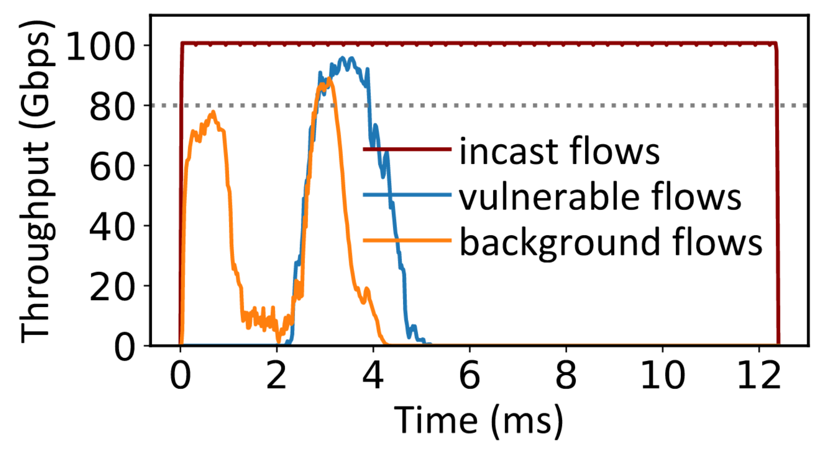
HOL Blocking Problem of Naive FC
PFC: The throughput of vulnerable flows and background flows is severely hurt due to HOL blocking.
Notes:
The result of PFC is shown on the screen.
⊕ During the first two microseconds, vulnerable flows are significantly blocked.
⊕ Between the first and second microsecond, congestion spreads to all of the pods, blocking background flows.
This result reveals that head-of-line blocking incurred by PFC significantly impacts the transmission of uncongested flows. Additionally, CBFC performs similarly to PFC, as they both control transmission at the granularity of the entire queue.

Slide 12
Idealized FC can Eliminate HOL blocking but is Non-scalable
Per-flow-queue FC: Vulnerable and background flows fully utilize the link, at the same time the throughput of incast flows does not downgrade.
Not scalable: There could be thousands of flows that can be observed on a port [1,2].
[1] (EuroSys18) Information rich flow record generation on commodity switches.
[2] (SigMetric24) Lightweight Acquisition and Ranging of Flows in the Data Plane.
Notes:
To overcome the head-of-line blocking caused by coarse-grained control, an idealized way is per-flow queue flow control, where only queues assigned to congested flows are paused and uncongested flows are unaffected.
⊕ However, this solution is not scalable as there could be thousands of flows observed on a port.

Slide 13
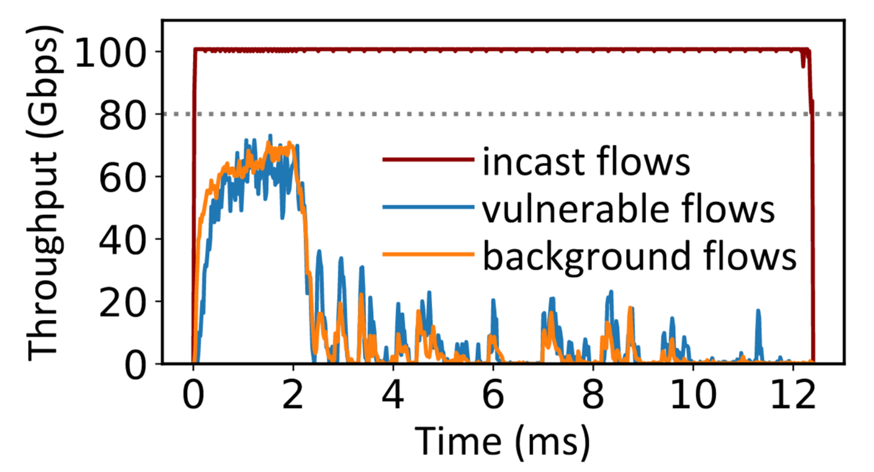
State-of-the-art FC is Flawed
BFC@NSDI22: Vulnerable and background flows sharing the same queue with incast flows are severely hurt.
Notes:
BFC, the state-of-the-art flow control, attempts to mimic per-flow-queue using a limited number of queues. When the number of active flows exceeds the number of queues, the remaining flows are randomly assigned to the already-used queues.
⊕ As shown in the figure, although many uncongested flows complete quickly, some flows take a long time because they randomly share queues with congested flows and suffer from head-of-line blocking.

Slide 14
State-of-the-art FC is Flawed
BFC@NSDI22: Vulnerable and background flows sharing the same queue with incast flows are severely hurt.
How to eliminate HOL blocking caused by
flow control in the most cost-effective way
Notes:
Given this situation, we raise the question:
How to eliminate head-of-line blocking caused by flow control in the most cost-effective way?

Slide 15
We Need a Better Control Granularity for Per-hop FC
PFC’s control granularity:
control the entire priority queue.
Head-of-line blocking.
Per-flow-queue’s control granularity: control at the flow granularity.
Non-scalable.
A better control granularity?
Blocking-free and scalable.
Notes:
Reviewing existing per-hop flow control protocols, we find that the key is control granularity. A coarse control granularity can lead to head-of-line blocking, while overly fine granularity can result in excessive resource consumption, making it non-scalable. Therefore, we need to find a better control granularity.

Slide 16
Analysis of Congestion in Per-hop FC
Vulnerable flows
Congested flows
P3
Root
Pause
Pause
P1
Hotspot
P4
P2
Leaf
P5
Notes:
Our analysis begins with the congestion in per-hop flow control, which is illustrated through this example.
In the example,
⊕ Five flows intersect at P2, causing congestion,
⊕ which then triggers pauses to P3, P4, and P5. As flows continue to transmit,
⊕ the queue lengths at P3, P4, and P5 increase, leading to pauses to upstream ports.

Slide 17
Analysis of Congestion in Per-hop FC
Vulnerable flows
Congested flows
P3
Congestion Root
Root
P1
Hotspot
P4
P2
Leaf
Congestion Tree
P5
Notes:
Analyzing the ports involved in this congestion event, we found they naturally form a tree structure. Only the congestion at P2 is unavoidable, and the congestion at other ports is triggered by pauses from P2.
⊕ Therefore, P2 is both the root of the tree structure and the root cause of the congestion, referred to as the congestion root.
// Ports that are both paused by the congestion root and pause other ports are called hotspots, while ports that are paused but do not pause any upstream ports are called leaves.

Slide 18
Analysis of Congestion in Per-hop FC
Key insight: Congestion root is the appropriate granularity of flow control!
Only control the flows passing through the congestion root.
Blocking-free.
The number of concurrent congestion roots observed on each port is moderate [3].
Scalable.
[3] (IMC) Network traffic characteristics of data centers in the wild.
Notes:
Since the congestion root is the root cause of congestion, the flows contributing to it form the minimal set that must be controlled. By only controlling these flows, other flows will not be blocked.
⊕ And the number of concurrent congestion roots observed on each port is moderate. Therefore, only a reasonably small amount of resources is required at each port, making the flow control scalable.
⊕ According to our analysis, we conclude the key insight of this work: congestion root is the appropriate granularity of flow control to achieve both blocking-free and scalable.

Slide 19
Pyrrha: A Congestion-Root-Based Flow Control
Queue allocation at P3
Vulnerable flows
Default output queue (OQ)
Congested flows
P3
Isolation queue (IQ) for root P5
Root
Pause
Pause
P1
Hotspot
P4
P2
Leaf
P5
Notes:
Based on the insight, we propose Pyrrha, a congestion-root-based per-hop flow control protocol.
Specifically, the Pyrrha switch will embed the congestion root ID in the pause frame. Upon receiving a pause frame, the upstream Pyrrha switch allocates an isolation queue dedicated to the congestion root. Then traffic passing through the congestion root is placed into the isolation queue. Traffic that does not pass through the congestion root remains unaffected by the congestion.

Slide 20
Pyrrha: A Congestion-Root-Based Flow Control
Queue allocation at P3
Vulnerable flows
Pyrrha is a HOL-blocking free per-hop FC protocol requiring the minimal number of queues.
Default output queue (OQ)
Congested flows
P3
Isolation queue (IQ) for root P5
Root
Pause
Pause
P1
Hotspot
（formally proven in the technical report released with our paper.)
P4
P2
Leaf
P5
Notes:
By leveraging congestion root as the control granularity, Pyrrha can be formally proven as a head-of-line-blocking-free flow control protocol requiring minimal queues. Please see the technical report released together with our paper for the formal proof.
However, to realize congestion root-based flow control, there are some challenges to be solved.

Slide 21
Key Challenge: Identify Congestion Root
HOL Blocking!
Vulnerable flows
Congested flows
P3
Root
P1
Hotspot
P4
P2
Leaf
P5
Notes:
The first challenge as well as the key challenge is identifying the congestion root accurately.
This is difficult in practice because upstream non-root hotspots can become congested before the actual congestion root. For example,
⊕ non-root port P3 might be congested first, and pause flows passing through it.
⊕ However, the true congestion root is P2.
⊕ If Pyrrha cannot converge to recognize P2 as the root, it can cause head-of-line blocking for the vulnerable flow that does not pass through P2.

Slide 22

Pyrrha Design: Distributed Congestion Root Election
P6
Queues at P3
Vulnerable flows
Default output queue (OQ)
I am the root!
Congested flows
$$K_{pause}$$
P3
Pause
Root
P1
Hotspot
P4
P2
Leaf
P5
Notes:
Inspired by the Spanning Tree Protocol, Pyrrha proposes a distributed congestion root election mechanism. This approach is based on the fact that congestion roots are always downstream, which ensures accurate root identification.
We use the following example to illustrate the process of distributed root election.
⊕ When there is no congestion, all flows are enqueued into the port's output queue.
⊕ If the output queue length exceeds the congestion threshold,
⊕ the port claims itself as the root and sends pause frames with its port ID upstream.

Slide 23
Pyrrha Design: Distributed Congestion Root Election
P6
Queues at P6
Vulnerable flows
Default output queue (OQ)
I am the root!
Congested flows
Isolation queue (IQ) for root P3
P3
Pause
Root
P1
Hotspot
P4
P2
Leaf
P5
Notes:
Upon receiving the pause frame,
⊕ the upstream port assigns an IQ dedicated to the congestion root
⊕ and enqueues the flow passing through the congestion root into the IQ.

Slide 24
Pyrrha Design: Distributed Congestion Root Election
P6
Vulnerable flows
I am the root!
Congested flows
P3
Pause
Root
Pause
P1
Hotspot
I am the root!
P4
P2
Leaf
P5
Notes:
When the downstream port P2 also experiences congestion, it identifies itself as the congestion root
⊕ and sends pause frames with its ID to the upstream ports.

Slide 25
Pyrrha Design: Distributed Congestion Root Election
P6
Vulnerable flows
P5 is the root!
Congested flows
P3
Merge
Root
Pause
P1
Hotspot
I am the root!
P4
P2
Leaf
P5
Notes:
Upon receiving this pause frame, the upstream port P3 relinquishes and recognizes P5 as the new congestion root.
After a new root is elected, Pyrrha merges the old congestion tree into the new one.
⊕ This process is achieved by sending Merge frames from the false-positive root P3 to upstream ports. When P6 receives the merge frame, it cancels the IQ assigned to P3, allowing the vulnerable flow to be free of the blocking.
After the actual congestion root arises, the congestion root election and merge process finishes within several link delays. Therefore, false-positive congestion roots have a minimal impact on performance.

Slide 26
Challenge 2: Identify Congested Flows
P6
Vulnerable flows
Congested flows
P3
Root
P1
Hotspot
P4
P2
Leaf
P5
Will the new flow pass through
the congestion root P2？
P7
Notes:
The second challenge is identifying congested flows.
Pyrrha actively identifies and controls congested flows rather than passively reacting after they reach the congestion root.
⊕ This approach prevents additional pressure from being placed on the congestion root by new flows.
⊕ To determine whether a flow will pass through the congestion root, the Pyrrha switch needs to identify the onward path of each flow.
This is challenging as various load balancing protocols may be applied in data centers, which can complicate determining the path of packets.

Slide 27
Challenge 3: Handle Tree-tangling Scenarios
Vulnerable flows
Congested flows
P4
Root
P1
P2
Hotspot
P5
P3
Leaf
P7
P8
P6
P9
Notes:
The third challenge is handling tree-tangling scenarios.
Several concurrent congestion trees can be intertwined among themselves. As an example, after a congestion tree forms with P2 as the root,
⊕ two additional flows from P8 and P9 are sent to P6 and then pass through P3.
⊕ The new flows, which are not part of the congestion tree rooted at P2, will cause P6’s OQ congestion, prompting P6 to declare itself the root and pause these flows.
In this case, two congestion trees tangle with each other.

Slide 28
Challenge 3: Handle Tree-tangling Scenarios
Vulnerable flows
Congested flows
P4
Root
P1
P2
Hotspot
P5
P3
Leaf
P7
P8
P6
Congestion Tree rooted at P2
P9
Notes:
The first is the congestion tree rooted at P5

Slide 29
Challenge 3: Handle Tree-tangling Scenarios
Vulnerable flows
Congested flows
P4
Root
P1
P2
Hotspot
P5
P3
Leaf
P7
P8
P6
Congestion Tree rooted at P6
P9
Notes:
And the second is the congestion tree rooted at P6

Slide 30
Challenge 3: Handle Tree-tangling Scenarios
Vulnerable flows
Congested flows
P4
Root
P1
P2
Hotspot
P5
P3
Leaf
P7
P8
P6
Tree-tangling
P9
Notes:
This results in P6 being both a hotspot and a congestion root, and the flow sent from P7 passes through two congestion roots, posing challenges for the flow control mechanism.

Slide 31
Challenge 3: Handle Tree-tangling Scenarios
Vulnerable flows
Congested flows
P4
Please see our paper for how Pyrrha identifies congestion flows and handles tree-tangling scenarios.
Root
P1
P2
Hotspot
P5
P3
Leaf
P7
P8
P6
Tree-tangling
P9
Notes:
For reasons of time, we omit Pyrrha’s design on the last two challenges. Please see our paper for details.

Slide 32
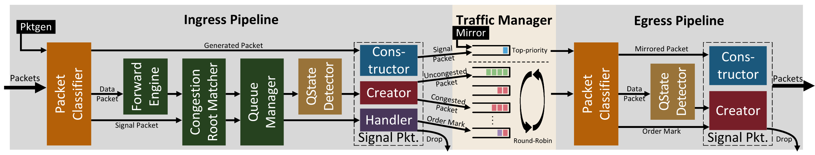
Pyrrha Prototype and Overhead Analysis
We implement a Pyrrha prototype on Tofino2 with 2.5k lines of P4 code and 2k lines of Python code.
Our Pyrrha prototype can easily scale to a k=36 fat-tree topology (≈10k hosts), with around 11 MB (44.5% of Tofino2) memory resource consumption.
Notes:
Pyrrha is implementable. We implement a Pyrrha prototype on Tofino2.
⊕ With careful optimizations, it requires only forty percent of Tofino2 memory resources to support around ten thousand hosts.

Slide 33
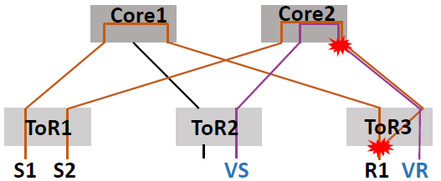
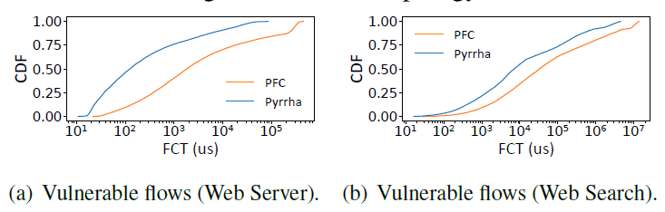
Testbed Evaluation
Pyrrha significantly reduces the FCT of vulnerable flows compared with PFC.
Topology: 2-stage clos topology with 2 cores and 3 ToRs.
Workload: Web Server and Web Search.
Notes:
We tested the performance of the Pyrrha prototype in a two-stage Clos topology where all switches are running Pyrrha. Under both web server and web search workloads, Pyrrha significantly reduced the FCT compared with PFC.

Slide 34
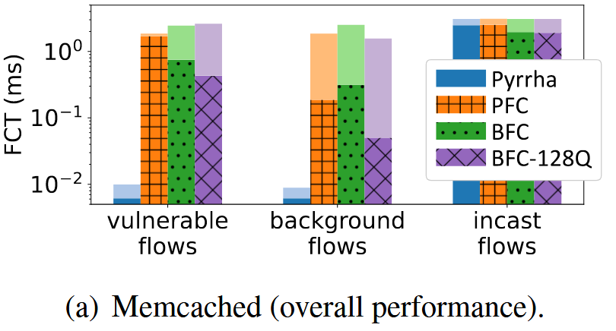
Simulation Evaluation
FCT in incast-mix scenario, compare with other FCs
Topology: 2-stage clos topology with 160 hosts.
Incast flows: periodically generated with average load at 0.5.
Vulnerable and background flows: generated following Poisson process with load at 0.8.
Basically the same
~200x
~30x
Notes:
Next, we give some simulation evaluation results on Pyrrha.
In a simulation with a one-hundred-and-sixty host topology, compared with other flow control protocols,
⊕ Pyrrha improves the performance of vulnerable and background flows significantly,
⊕ without compromising the performance of congested flows.

Slide 35
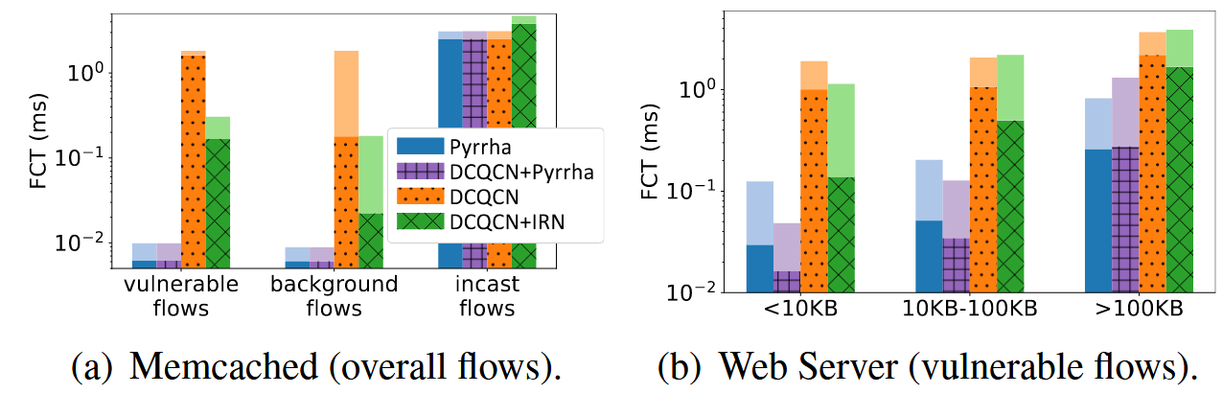
Simulation Evaluation
FCT in incast-mix scenario, with or without CC
~150x
~20x
~2x
~2x
Pyrrha significantly benefits uncongested flows compare with pure CC solution.
Pyrrha can cooperate with existing CC to achieve better performance for small flows.
Notes:
Compared with a pure congestion control solution,
⊕ Pyrrha also significantly benefits vulnerable and background flows without compromising congested flows.
⊕ When Pyrrha cooperates with congestion control, the performance of small flows is further improved.

Slide 36
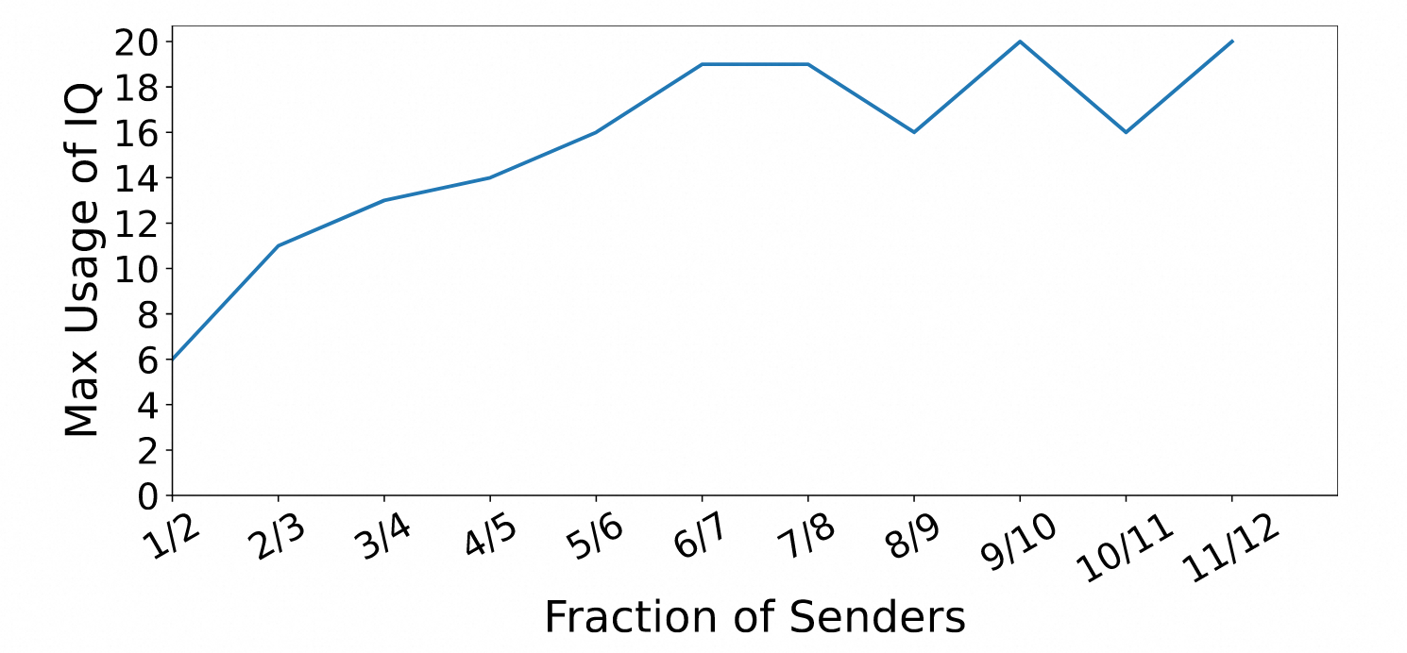
Simulation Evaluation
Pyrrha’s queue usage is moderate
Topology: standard fat-tree with k=16 (1024 hosts).
Most stressful workload: (m − 1) out of m ToRs send traffic simultaneously to the left 1/m of the ToRs.
Notes:
We also investigate the worst-case queue usage of Pyrrha. In a simulation with 1024 hosts and the most stressful workload, Pyrrha’s queue usage is under twenty, which is moderate.

Slide 37
Conclusion
Pyrrha is a congestion-root-based per-hop flow control, which can control the transmission of flows at a fine granularity without HOL blocking while requiring only a minimal number of queues.
It is time to embrace per-hop flow control to react to congestion promptly！
Thanks！
Find our open-source code on: https://github.com/NASA-NJU/Pyrrha
Notes:
Finally, let me make a conclusion.
Pyrrha is a congestion-root-based per-hop flow control protocol, which can control the transmission of flows at a fine granularity without HOL blocking while requiring only a minimal number of queues.
Through Pyrrha, we demonstrate that a head-of-line blocking-free, scalable flow control is feasible. We believe that it is time to embrace per-hop flow control to react to congestion promptly.
// Our codes are publicly available online as a contribution to the research community and to ensure reproducibility.
Thanks for listening.

