Slide 1



Anytest: Localizing the Root Cause of Hardware Transport Performance Anomalies
Zhaochen Zhang, Jiaqi Gao, Sheng Cheng, Peiwen Yu, Feiyang Xue, Chang Liu, Boliang Liu, Kun Liu, Yubin Li, Rui Li, Li Wang, Peirui Cao, Qingkai Meng, Guihai Chen, Gang Lu, Bo Shi, Shuguang Cheng, Shu Ma, Yongqing Xi, Binzhang Fu, Dennis Cai, Chen Tian

Slide 2


Offloading: performance gain and debugging pain.
Software Network Stack
tcp_cubic.c
sch_codel.c
tcp_input.c
Sender
Switch
Receiver
Offloading
Fast & near-zero CPU overhead!
RDMA Network Stack
Blackbox hw. logic
Blackbox hw. logic
Blackbox hw. logic
Sender
Switch
Receiver

Slide 3

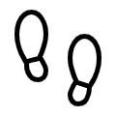





It’s easy to detect the problem, but hard localize it.
Monitor
NPA Diagnosis
Packet
Loss!
RDMA actions
Repro. cases
Root cause
NPA
RDMA-tracer
Synapse
Localization
Fix or mitigation
User
Trace application
behavior
Reproduce
the NPA
Is ECN ignored?
Other Senders
Loss
ECN marking
Congestion
Control
×
CNP
Reply
Sender NIC
CNP interval
Switch
Receiver NIC
Is CC too
aggressive?
Is CNP interval
too large?
Is bandwidth
sched. unfair?
Is max queue
length too short?
Is ECN mark
too fewer?
Please see our paper for details of RDMA-tracer and Synapse, two of our internal tools.

Slide 4
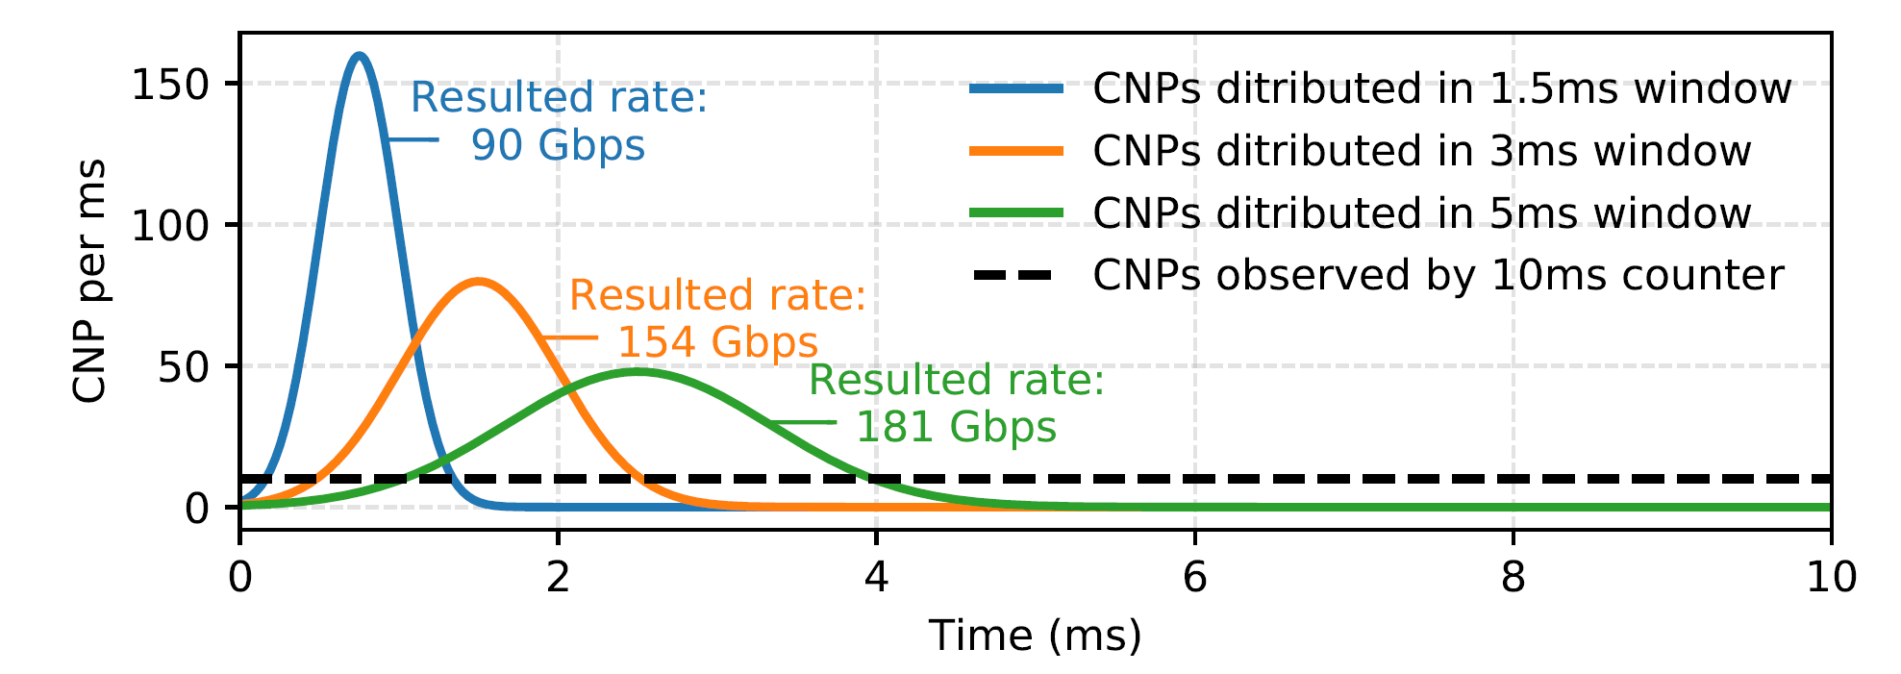
Current counter-based monitor is coarse-grained
Transport reacts at sub-μs scale; counters aggregate over 10 ms – 1 s.
The same 10 ms counter value can produce 90–181 Gbps flow rate.
Aggregation erases the timing needed for diagnosis.

Slide 5
RDMA network is tightly coupled
Sender, switch, and receiver form a closed feedback loop
Counters show correlation—not the responsible RP, NP, or CP
Is ECN ignored?
Other Senders
Loss
ECN marking
Congestion
Control
×
CNP
Reply
Sender NIC
CNP interval
Switch
Receiver NIC
Is CC too
aggressive?
❓
Is CNP interval
too large?
Is bandwidth
sched. unfair?
Is max queue
length too short?
❓
Is ECN mark
too fewer?

Slide 6
Requirements of production-level localization tool
𝜇s- & packet-level resolution.
Event injection: Reproduce controlled anomaly triggers.
In-situ testing: Test the affected hardware in its production environment.
Decompose the interaction.
Method | Resolution Throughput Event . |  | Decompose | Inject | In-situ
Inference from counters | sec | Flow
Hardware testers | μs | Pkt
Test-suite generators | sec | Flow
Anytest (ours) | μs | Pkt

Slide 7





Anytest: test the black box with white boxes
Key idea: surrounding the hardware with white-box software endpoints.
Orchestrator
Env. setup
Start testing
Collection&Analysis
Standard RDMA verbs
Config
Result
Target COTS Hardware
Hosts in production cluster
Black-box Logic
White-box emulation
High precision measurement
Functionality
Event injection
DPDK emulator

Slide 8

Test each network role using specific scenarios
RP Test Scenario
NP Test Scenario
DPDK emulator (RP)
Target COTS NIC (RP)
DPDK emulator (RP)
DPDK emulator (RP)
DPDK emulator (RP)
ACK/NACK/CNP
us-level record
Legacy / Programable CC
ACK/NACK/CNP
us-level record
ACK/NACK/CNP
us-level record
ACK/NACK/CNP
us-level record
Tx Scheduling
QoS
Data Packet
ACK& CNP
ACK
NACK CNP
Data Pkt w/ ECN
ACK Reply
CNP Inject
ACK/NACK Reply
CNP
Reply
Send Data Pkt
with ECN
us-level Tput & Pkt delay
DPDK emulator (NP&CP)
Target COTS NIC (NP)
DPDK emulator (CP)
Please see CP test scenario in our paper……

Slide 9
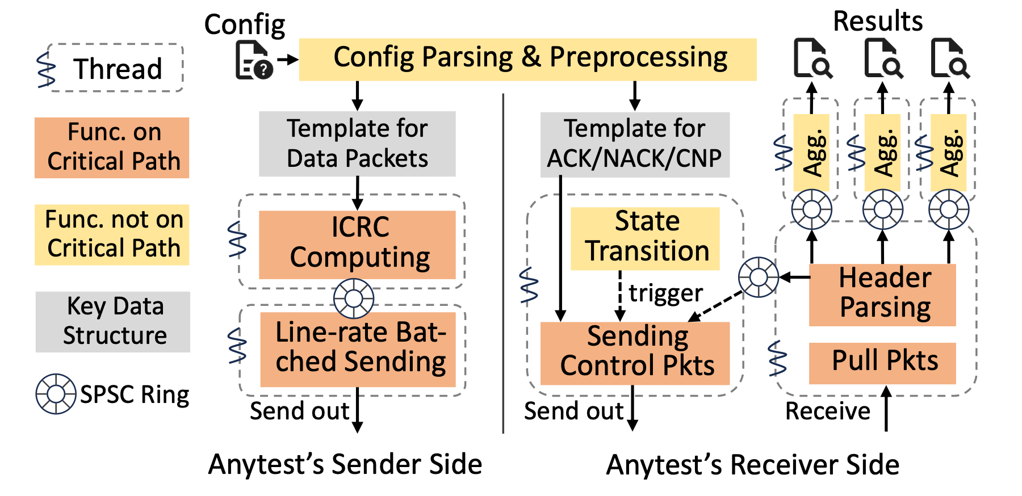
Catching the line rate
Dedicated threads isolate the critical datapath.
Lock-free SPSC rings preserve throughput and ordering.

Slide 10
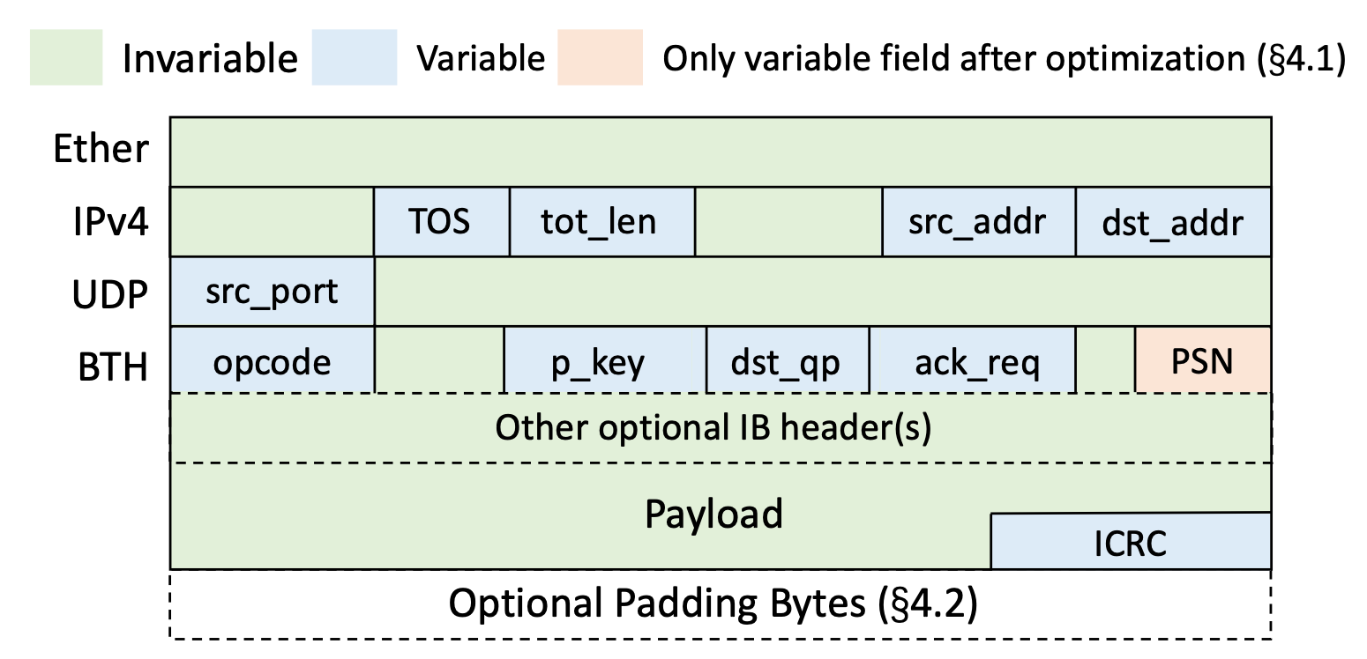
Catching the line rate
Pre-build invariant packet fields; update only the PSN at runtime.
Avoids per-packet allocation and payload initialization.
O(1) ICRC computation over the entire packet. See the paper for the algorithmic details

Slide 11
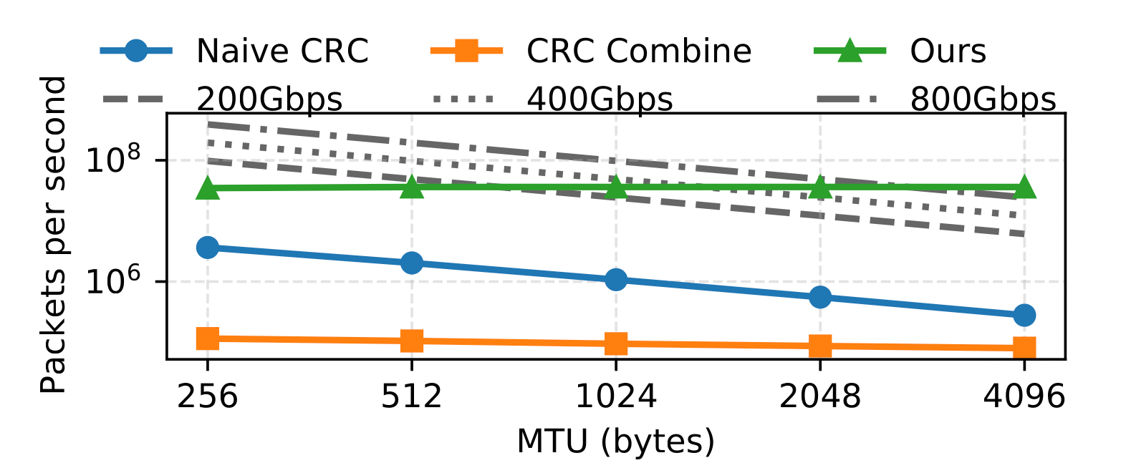
Catching the line rate
Anytest can support 200 Gbps at 1 KB MTU, and 800 Gbps at 4 KB.

Slide 12
AnyTest Production Deployment Workflow
Anytest reduced the average localization effort to 3.1 person-hours per case
Symptom Captured & Reproduced
The only labor-intensive step
Pick Track(s): CC / LR / Scheduling
iterate
Role-Isolated Regression Test
codify the
new test case
into the
regression suite (offline)
Find Failing Role/
Function Class?
No—32.8%
On-Call Joint Localization
Yes—67.2% (automated)
Sweep to Trigger
Root Cause Localized

Slide 13
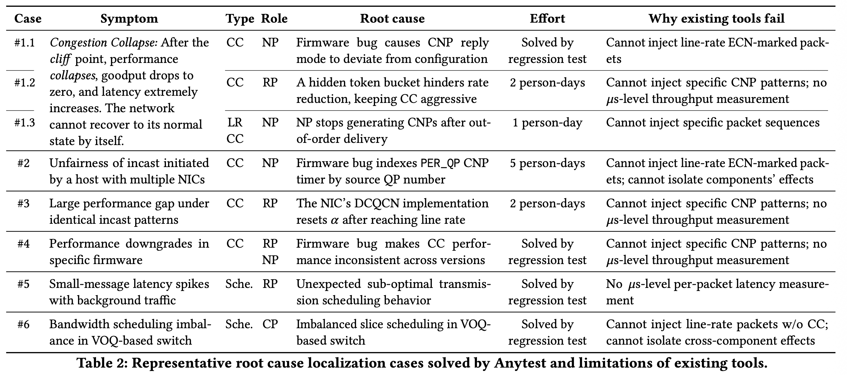
Case study
Please see our paper for all representative cases……

Slide 14
Conclusion
Anytest is an in-situ, role-isolated black-box testing tool that turns RDMA root-cause localization into controlled experiments.
Fine-grained testing makes opaque, hardware-offloaded transports systematically diagnosable.
At Alibaba, Anytest localized 58 production NPAs, directly solved 67.2%, and reduced mean localization effort to 3.1 person-hours.
Thanks！
Find our open-source code at: https://github.com/AlibabaResearch/Anytest

